Slide 1
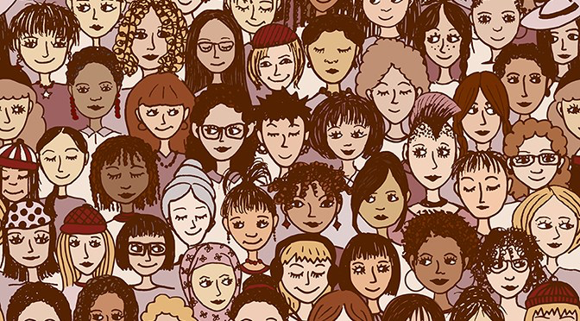
Where are the Women? Famous Females in the Psychology Curriculum
Sarah Mead
University of South Florida
NCSS 2017

Slide 2
In what ways have women contributed to the field of psychology?
Notes:
How many women can you name from your curriculum off the top of your head?

Slide 3
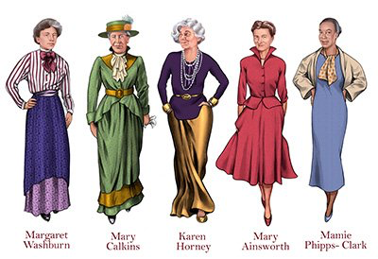

Slide 4
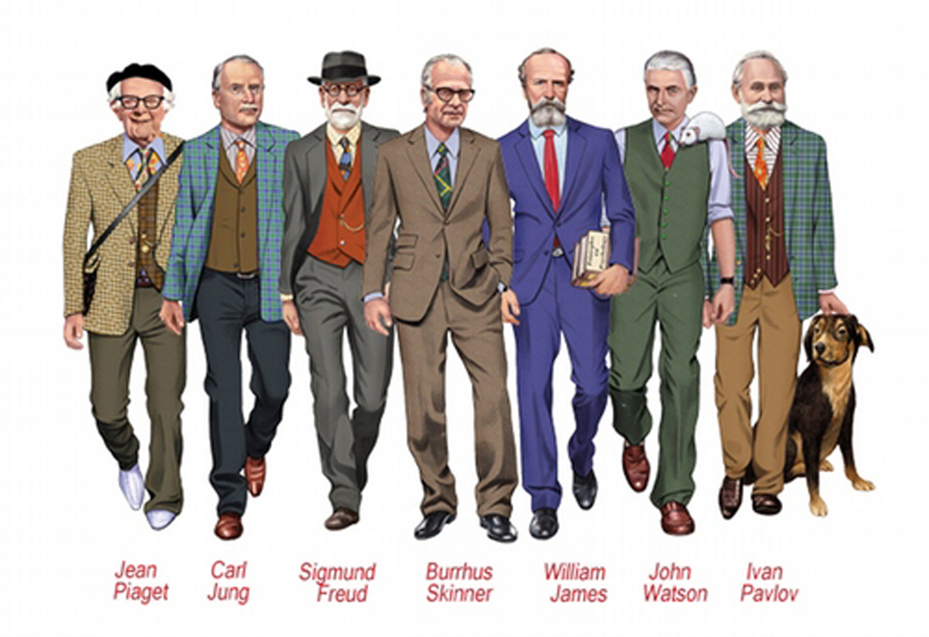

Slide 5
Gender-Balanced Curriculum
Nearly twice as many female students are enrolled in AP Psychology as compared to male students nationwide (College Board, 2015).
How does your curriculum measure up?
Notes:
In 1970, women made up 20% of Phd recipients in psychology. In 2005, 72% of new PhD and PsyDs in psychology were women

Slide 6
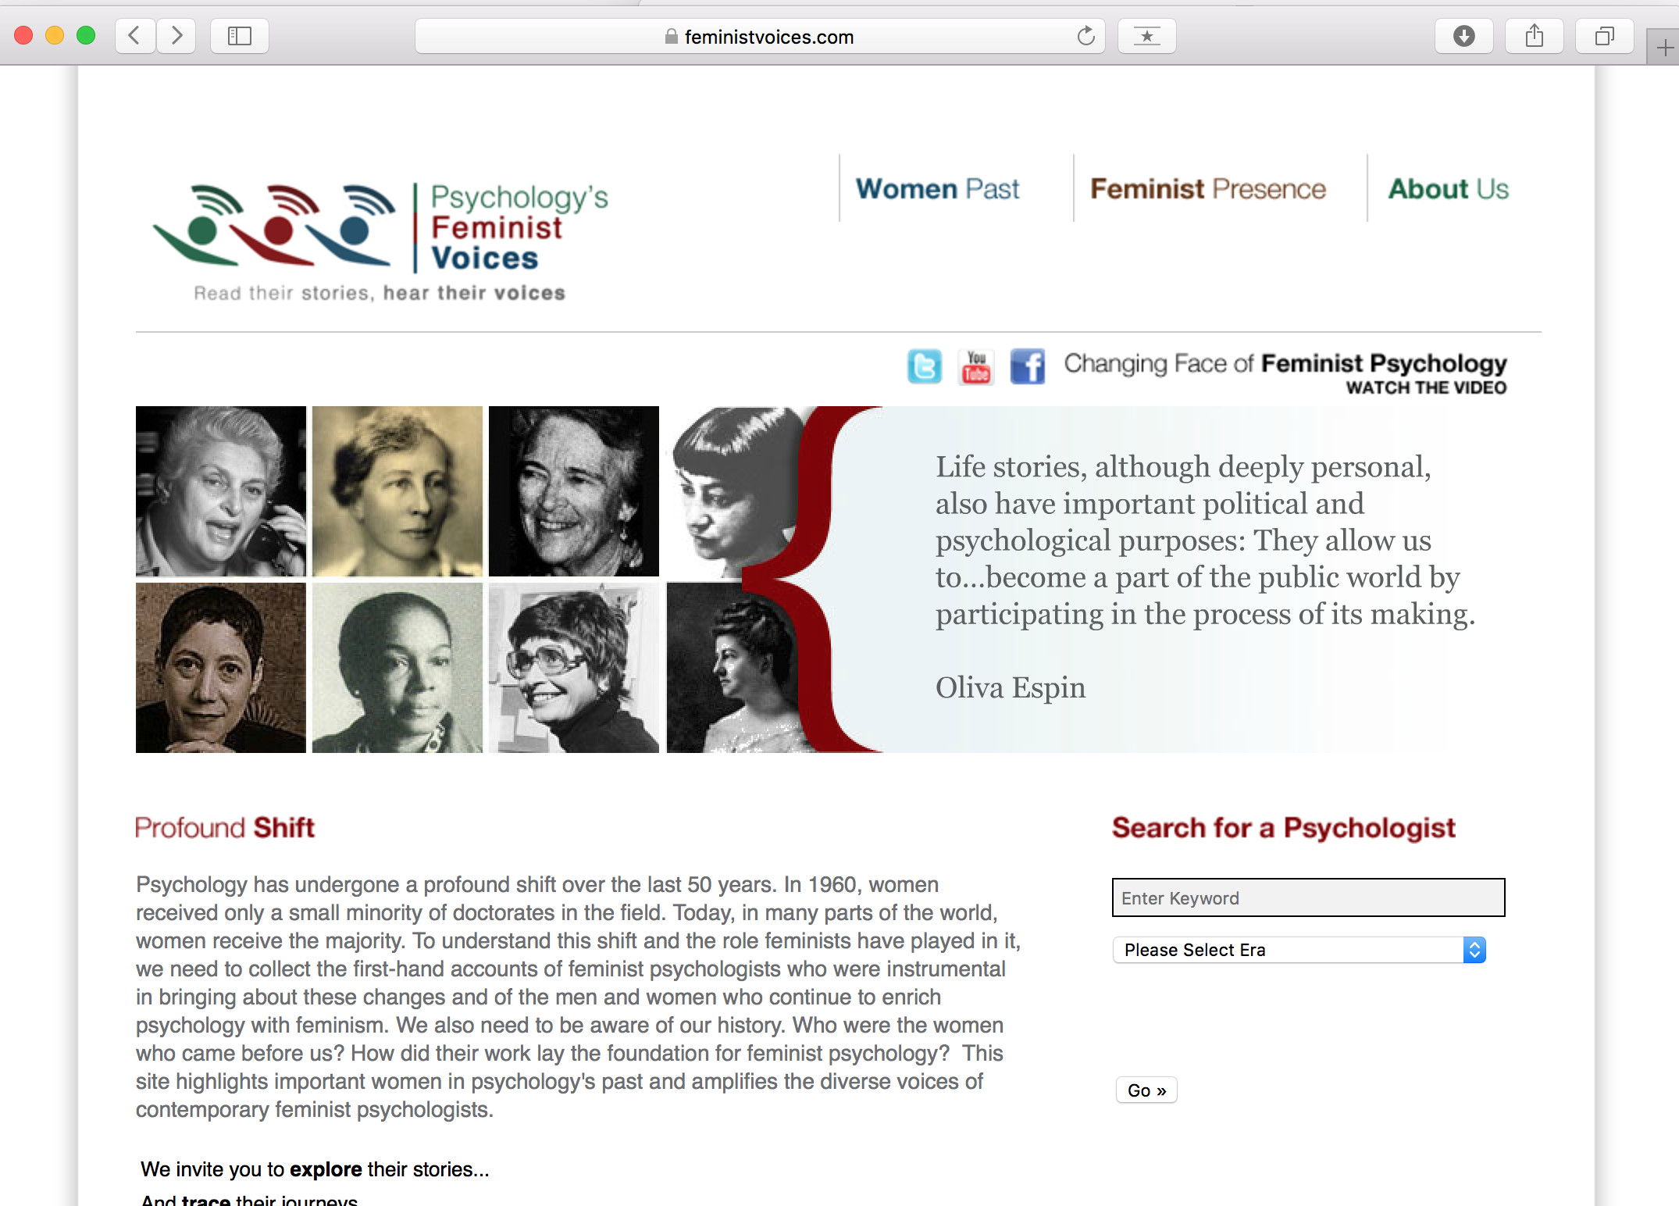
Psychology’s Feminist Voices

Slide 7
Psychology’s Feminist Voices

Slide 8
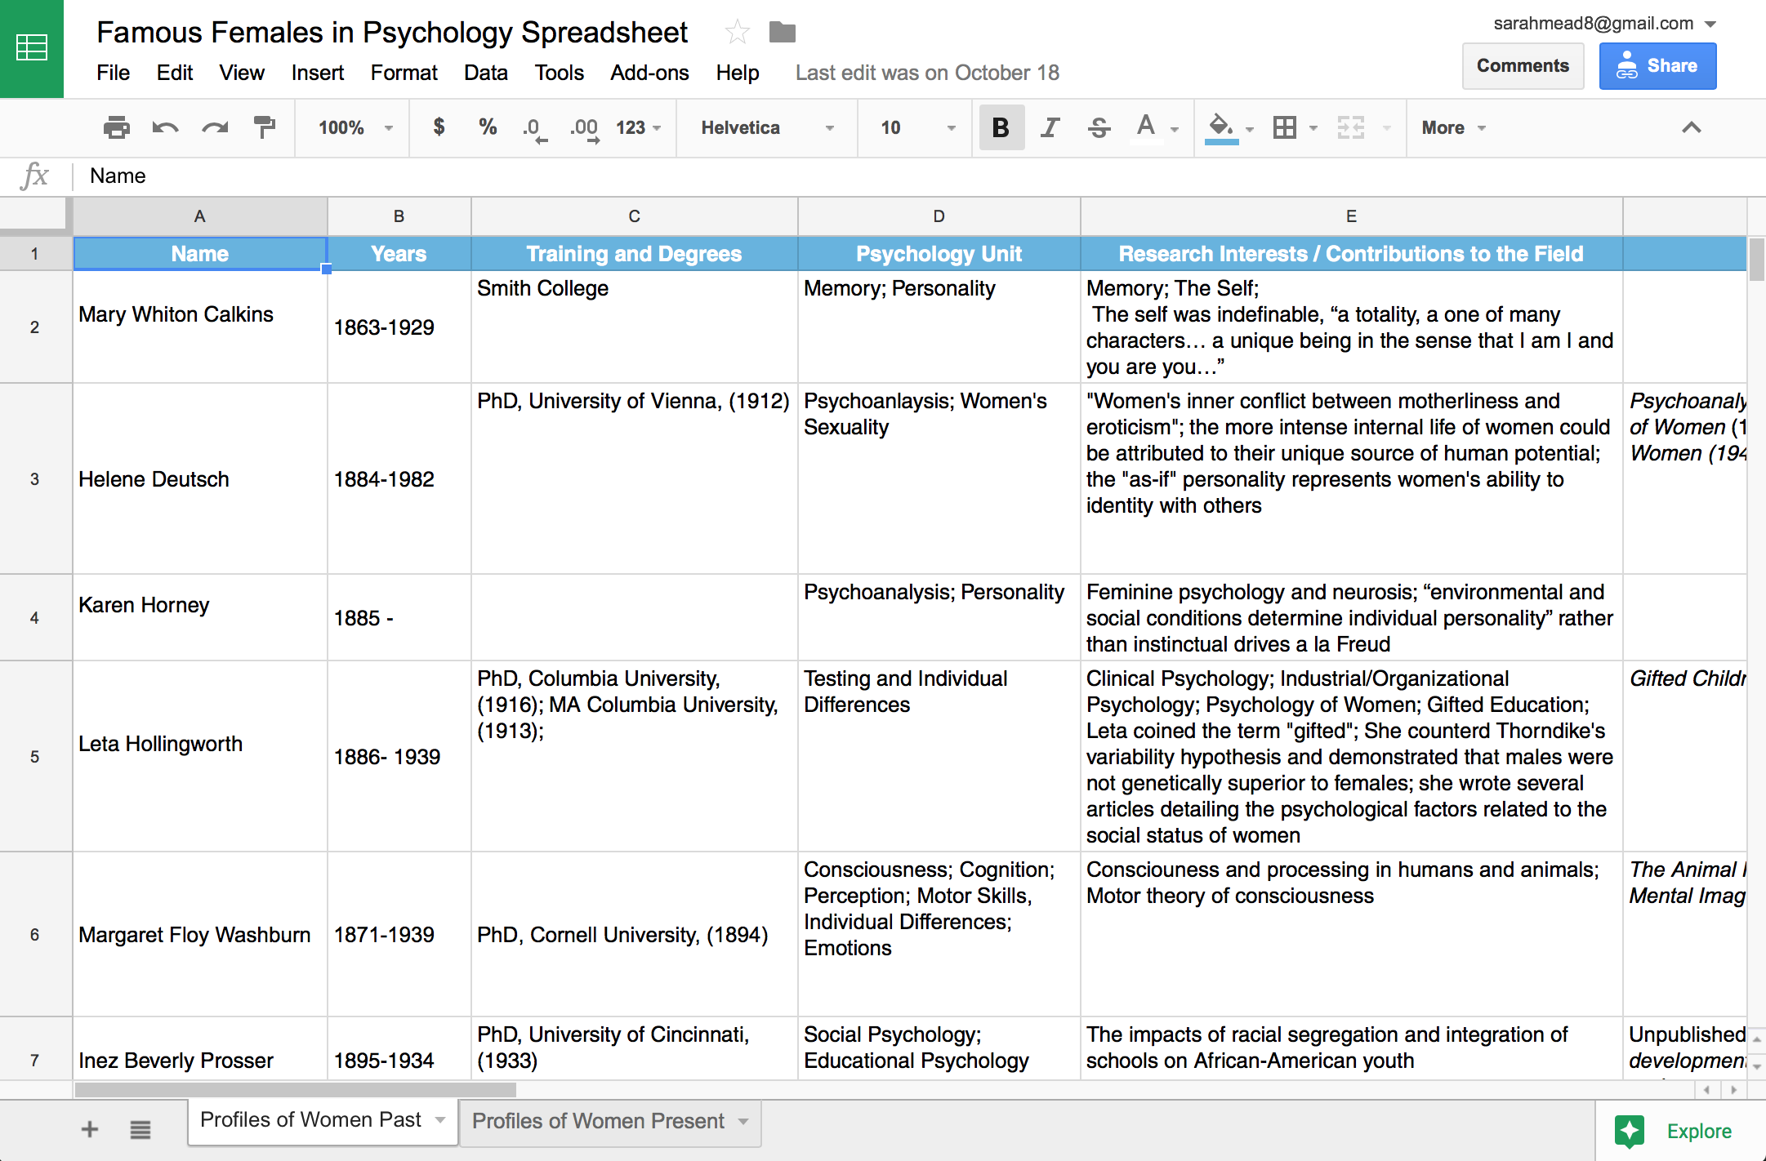
Famous Females in Psychology Spreadsheet

Slide 9
goo.gl/KN8LuX

Slide 10
Biographical Sketches

Slide 11
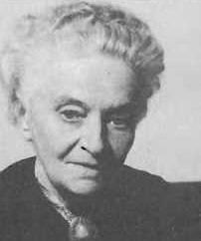
Helene Deutsch
First woman to lead Freud’s Psychoanalytic Society
“As-if” personality in women allows greater empathy
Intense internal life of women is connected to their unique source of human potential
1884 - 1982

Slide 12
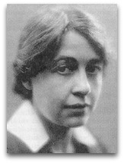
Leta Hollingworth
Administered Binet Intelligence Test in NYC
Studied educational psychology under E.L. Thorndike at Columbia University
Dissertation concluded that there is no empirical evidence to support that women have diminished mental capacities during menstruation (1916)
Gifted Children (1926)
1886 - 1939
Notes:
MA Columbia, 1913; PhD Columbia, 1916;
http://www.feministvoices.com/leta-hollingworth/

Slide 13
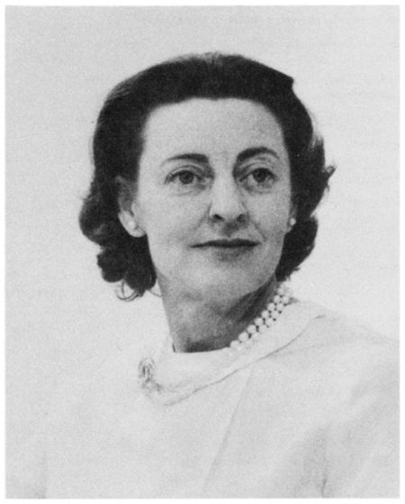
Margaret Keunne Harlow
Child development
Contact Comfort
Director of the Primate Lab at the University of Wisconsin
Dismissed from her position due to nepotism
1918 - 1971

Slide 14
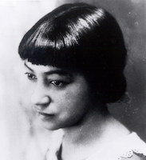
Inez Beverly Prosser
First African-American woman to earn her Ph.D. in Psychology
Dissertation work on the impact of racial segregation and integration on African-American youth.
1897 -1934

Slide 15
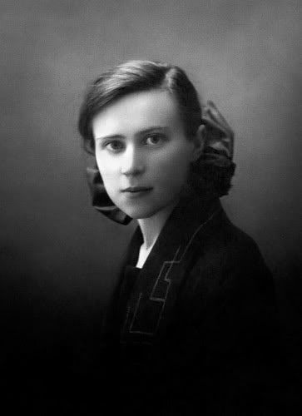
Bluma Zeigarnik
Zeigarnik effect: individuals had more clear memory for incomplete or uninterrupted tasks than tasks that had been successfully completed.
Some of her professors included Wolfgang Kohler and Max Wertheimer
1895 - 1934

Slide 16
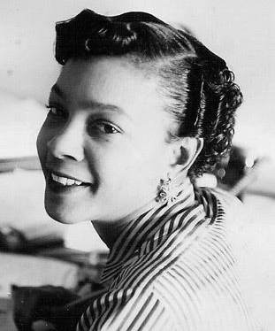
Mamie Phipps Clark
Began her academic career majoring in math and minoring in physics at Howard University
Master’s Thesis: The Development of Consciousness of the Self in Pre-School Children
Doll Test from Brown v. Board of Education Supreme Court Case
1917 -1983
Notes:
Kenneth Clark convinced her to study psychology because unlike math and physics it was a promising career field; Kenneth Clark was the first African –American to earn a PhD in psychology from Columbia, Mamie was the second

Slide 17
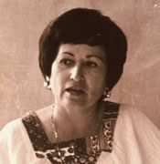
Martha Bernal
First Latina to earn a Ph.D. in the United States
Increased cultural relevance of of clinical training for minorities.
Founder of the National Hispanic Psychology Association
1931 -2001

Slide 18
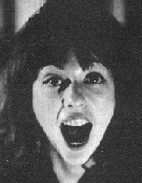
Naomi Weisstein
Experienced overt gender discrimination on her first day as a post doc at Harvard
Criticized the field of psychology for failing to understand women
Psychology Constructs of the Female (PCF), 1968
1939 - 2015

Slide 19
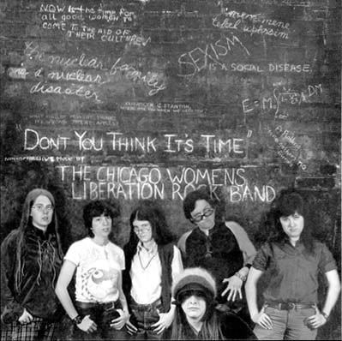

Slide 20
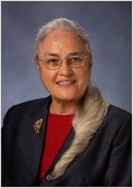
Carolyn Attneave
Cross-cultural society and Native American Mental Health
Became interested in psychology after serving in the Coast Guard during WW2
Oklahoma State Department of Health
Harvard School of Public Health
1920 - 1992
Notes:
Network Therapy – focusing on network therapy – individual relies upon support networks as an alternative to hospitalization. Networks includes family, friends and community. Practitioners in Philadelphia lacked understanding of their Black clients

Slide 21
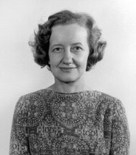
Brenda Milner
Founder of Cognitive Neuroscience
The case of H.M.
Memory formation in the brain
Foundational research on Hemispheric specialization
1918 – present (Age 99)

Slide 22
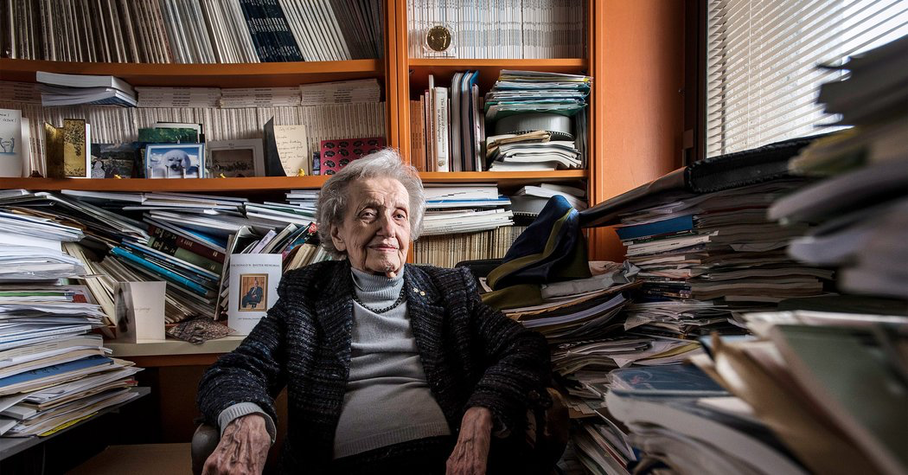
Notes:
https://www.nytimes.com/2017/05/15/science/brenda-milner-brain-cognitive-neuroscience.html

Slide 23
What are the implications for infusing the contributions of women?

Slide 24
Primary Resource
Pyschology’s Feminist Voices. (2010). http://www.feministvoices.com/about

Slide 25
goo.gl/KN8LuX
Thank You!
sarahmead8@gmail.com

