Slide 1
Sports and Psychology
NCSS ANNUAL MEETING
St. Louis, MO
November 22, 2013
Sean Tischler
Salesianum School
stischler@salesianum.org

Slide 2
Sports and Psychology Class
Objective for today
Provide you guys with some possible information to supplement your lecture
Provide some activities
Some lesson plans
And a few small projects

Slide 3
Concussions and Perspectives
National Center for Biotechnical Information- Great Resource for Scientific Articles on Brain Trauma
6 Perspectives on the ‘Crazy Celebrity”
Chris Henry-Speeding, Marijuana, “Embarrassment to program”, drinking with underage girls, on and on
Chronic traumatic encephalopathy or “punch drunk”- biological cause, aggression, memory loss, dementia, confusion (Romonowski, Favre, Dorsett),
21 year Old Owen Thomas- University of Penn
Junior Seau
Chris Benoit
Athletes are now donating brains upon death, Pat LaFonataine, Ted Johnson, tons of wrestlers
Suicide and link (not cause) with concussions in football (and military)
Concussions linked with severe depression, but so is retirement….14% compared with NFL retirees- So is the depression cognitive or biological, both, good discussion for the perspective sections.

Slide 4
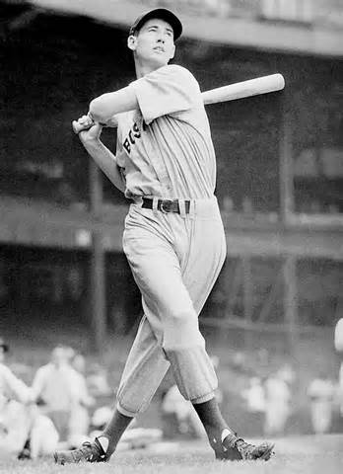
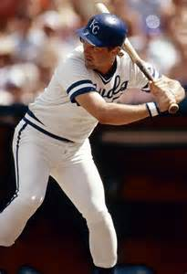
Research Methods and Statistics
What has happened to the .400 hitter in baseball?
What has changed in baseball since Ted Williams hits .406 in 1941
Night Baseball (split stats/correlations)
Mounds are higher (1968)
Dimensions of ballparks
Introduction of African-American players in 40’s
Introduction of Latin players 1950’s
Extensive travel schedule
More games (would ted Williams kept .400)
Canadian Maple bats
Media Pressure
Strike Zones in the 90’s
Performance Enhancing Drugs
lower end batting averages may be higher because of the DH rule.
Specialty Pitching-but with more teams is pitching diluted
Or is just overall a better athlete at every position?
What has not changed since the last .400 hitter?
The rules-most sports have seen major rule changes that have essentially changed the games making in difficult to compare eras
The mean (average) has stayed incredibly close to .260, some years it deviates slightly, but consistently within a few points either way.

Slide 5
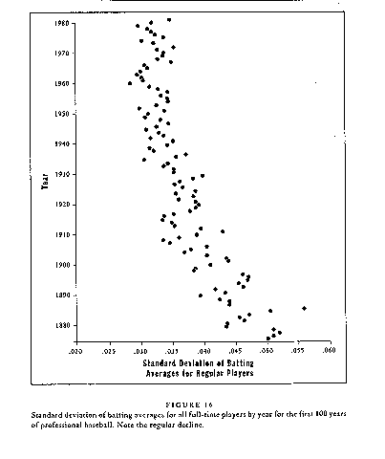
Here is chart from Gould’s book which shows the shrinking Standard Deviation since 1890’s.

Slide 6
Ted Williams-Standard Dev. Approx .40
.260
.300
.340
.380

Slide 7
George Brett-Approx. .35
.260
.295
.330
365

Slide 8
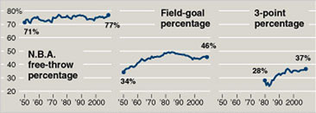
What is about the Free Throw?

Slide 9
Other Research and Worksheet Ideas
Homerun Trot Time -David Ortiz
Homerun Trot Time- David Dietrich
Trot Times
Stolen Base Worksheet
NCAA BASKETBALL CHAMPIONS AND FREE THROWS
Salaries and Production- Does an increase in salary increase production? Final Year of a contract and popular belief. Sport Salaries
Research the homerun leaders for both leagues over the past 30 years. What years/players have the largest range from first to 3rd. Are there any patterns?
An analysis of some other baseball statistics or statistics from other sports may lead to similar conclusions those of Gould. Some similar studies have been done by members of the Society for American Baseball Research (SABR).
An article in the Boston Globe in March 1997 hinted that, considering parity in the NBA, the 1996-97 Celtics may very well be among the worst teams in history (relative to the league in a given year). This could be a topic for study.-or anything similar to this.

Slide 10
Illusory Correlations in Sports
Does the team that wins groundballs always win the lacrosse game?
Does the turnover battle in football really matter?
Do the teams that make throws win more often?

Slide 11
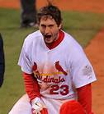
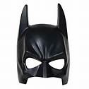
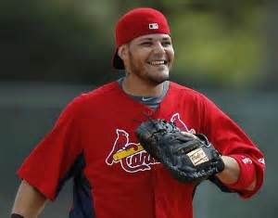
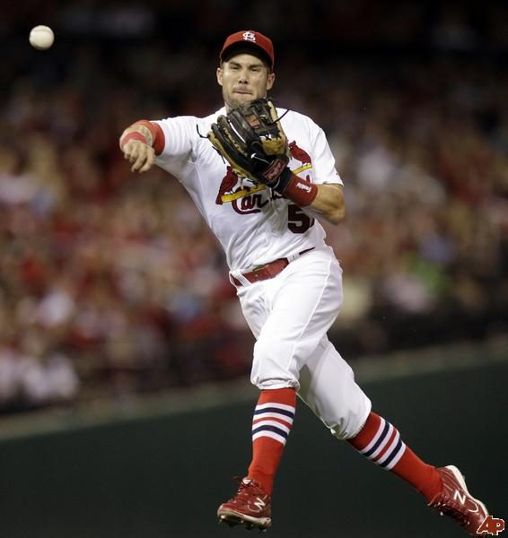
Behaviorism and Sports
Superstitious Pigeons
In Humans- Superstitions Conditioning
Good Morning America
Baseball Players and Superstition
Interview a coach, player, fan

Slide 12
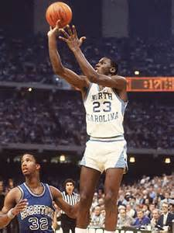
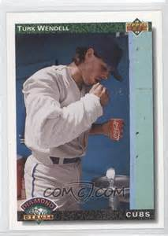
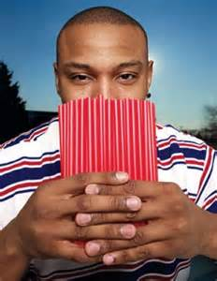
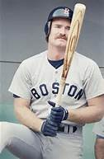
Other Superstitions
1.Three Types of Superstitions
Rituals
Taboos
Fetish or Lucky Charm
2.Difference between rituals and superstitions
3.The majority of superstitions are developed because the player has related two random events together, therefore generating an illusory correlation (Durham, 2010).

Slide 13
Intelligence Testing
Wonderlic Test
What is it exactly? An aptitude test, measures cognitive abilities
Created in 1936
Lets take a look at an example the athletes get at the combine. Wonderlic Test
Lets take a look at the scores and see if there are any correlations
Students can use the Wonderlic Scores for a correlation homework
Wonderlic Score and Touchdown passes
Wonderlic Scores and Salary Made during career
Ect.
Does the test have any predictive validity? Content Validity?
Does the test have reliability?
What about the AP Psychology Test?
Content Validity
Predictive Validity
Reliability
Strong link between Emotional Intelligence and Retired Athletes quality of life

Slide 14
QB Scatterplot- -0.3024422557127921

Slide 15
Developmental
Malcom Gladwell and Outliers
What benefits of sports for young females – Billy Jean King Women’s Foundation
The Psychological, Sociological, and Physiological benefits for girls to play sports
If you let me play – Is there evidence to back up the claims-tons of articles/research on the website
The Women’s Sports Foundation Report
Heart Disease
Cancer
Alzheimer’s and Dementia
Depression
Suicide
Self-Esteem and Body Image
Mathematics and Science Achievements
What are the positives and negatives of the following age groups participating in sports
Young Children (7-10)
Pre-Adolescent (10-13)
Adolescents (13-18)
Hoop Dreams Documentary after AP test

Slide 16
Performance Enhancing Drugs
Is it more or less ethical to take PED’s for grade improvement or for athletic edge?
Attitudes Questionnaire and Performance Enhancing Drugs
Small Research Paper on Performance Enhancing Drugs
The effects of LSD on performance
Athletes who have admitted to being under the influence of drugs DURING games-
Gary McClain-Cocaine (does cocaine enhance performance)
Tim Raines-Cocaine
Doc Ellis-LSD
Bernie Carbo-Marijuana, Alcohol, Amphetamines

Slide 17
Samples of positive uppers IOC
Year | Total A samples analysed | Number of positive samples with stimulants | % Positive samples with stimulants
2004* | 169187 | 382 | 0.23
2003* | 151210 | 516 | 0.35
2002† | 131373 | 392 | 0.30
2001† | 125701 | 352 | 0.28
2000† | 117314 | 453 | 0.39
1999† | 118243 | 532 | 0.45
1998† | 105250 | 412 | 0.39
1997† | 106561 | 356 | 0.33
1996† | 96454 | 281 | 0.29
1995† | 93938 | 310 | 0.33
1994† | 93680 | 347 | 0.37
1993† | 89166 | 331 | 0.37
1992† | 87808 | 277 | 0.32
1991† | 84088 | 221 | 0.26
1990† | 71941 | 340 | 0.47
1989† | 52371 | 508 | 0.97
1988* | 47069 | 420 | 0.89

Slide 18
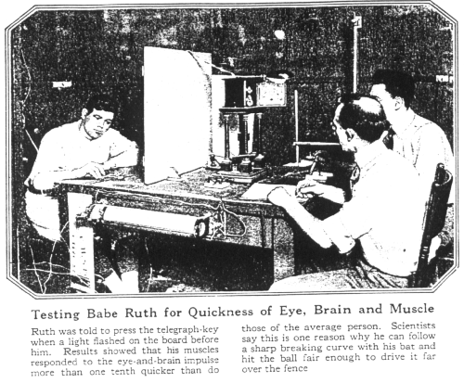
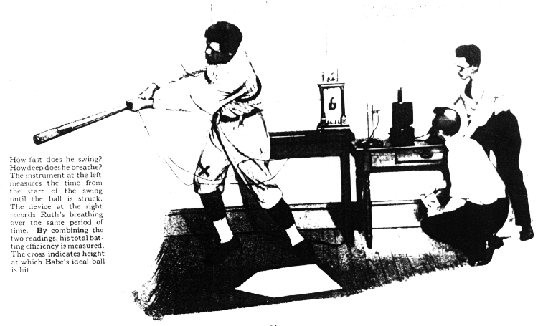
Perception, Sensation, and the Brain-”Baseball is 90% mental, the other half is physical”-Yogi Berra
http://www.psychkits.com/perception_goggles.html
Shooting Hoops
Tossing the pigskin
Babe Ruth- More Brain than Bone
Why is Babe Ruth the best?
90% effiecent vs. 60%
Eyes 12% faster
Ears 10% faster
His nerves were steadier than 499 of 500 studied
Attention and quickness of perception was 1 and half times faster than the average human being
Albert Puljos- More Brain the Brawn
Utley is a beast!
Jeter’s Flip!

Slide 19
Psychology of the Sports Fan
Are we fans or fanatical?
Great supplementary book for AP Psych Amongst the Thugs
Fans and spectators fall into different categories
BIRGing (basking in reflected glory) and CORFing (cutting off reflective failures).
Identity Theory and Social Identity
Deindividuation
In-Group and Out-Group Bias
BIRFing and CORFing
Most of the literature focus is on college sports
ID Theory-role-identity theory, which suggests that individuals will base their actions on how they like to see themselves and how they like to be seen by others
SI Theory-based on Festinger’s (1954) social comparison theory, which suggests that individuals will strive to attach themselves to other individuals who are similar or slightly better. Social identity theory, therefore, focuses on the ways in which individuals perceive and categorize themselves, based on their social and personal identities. Rather than emphasizing role and role behaviors, social identity theory emphasizes group processes and inter-group relations.

Slide 20
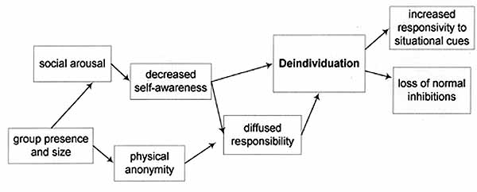
Deindividuation

Slide 21
Personality and Sports
Internal and External Locus of Control- My Coach Sucks
Personality Inventories for Athletes
TAP
The Winning Profile Athletic Instrument
Athletic Motivation Inventory

Slide 22
Motivation and Emotion
Intrinsic (pleasure of learning, pleasure of senses, surpass) Vs. Extrinsic- Does the type of motivation matter?
Why goal setting so important
Publicly vs. Privately Stated
Arousal and Anxiety in Sport
Two types of anxiety in Sports for coaches to know
Somatic-sweaty palms, “butterflies”, nausea, ect
Cognitive-fear of failure, loss of self-esteem
Catastrophe Theory-relationship with personality section, introverts and extroverts and levels of arousal, Eyesneck’s personality inventory Sport Competition Anxiety Test
Drive Theory-linear and proportional relationship between arousal and performance (not a good explanation)
Inverted U Theory-peak, lowest level of arousal will begin in different areas for different sports
Hardy’s Catastrophe Theory
Jones and Swain Theory-Depends on the cognitive perception- does it facilitate or debilitate?

