Slide 1
Not Tacked On: Effectively Incorporating Diversity in Introductory Psychology
Steve Jones
City of Medicine Academy
Durham, NC
NCSS November 2012

Slide 2
Who am I?
I teach … | in a small public high school | AP Psych in one semester
I tweet … | @highschoolpsych | in #psychat (Thursdays @8 ET)
I blog … | at Teaching High School Psychology | (tinyurl.com/hspsych)
I serve … | as Chair-elect of the APA’s TOPSS committee | (TOPSS = Teachers of Psychology in the Secondary Schools)
I gather … | images on Pinterest | videos on YouTube
Thanks to TOPSS for allowing me to present at NCSS.
Don’t forget the Psych Community/TOPSS reception tonight at 7! (P.S. T-shirts!)

Slide 3
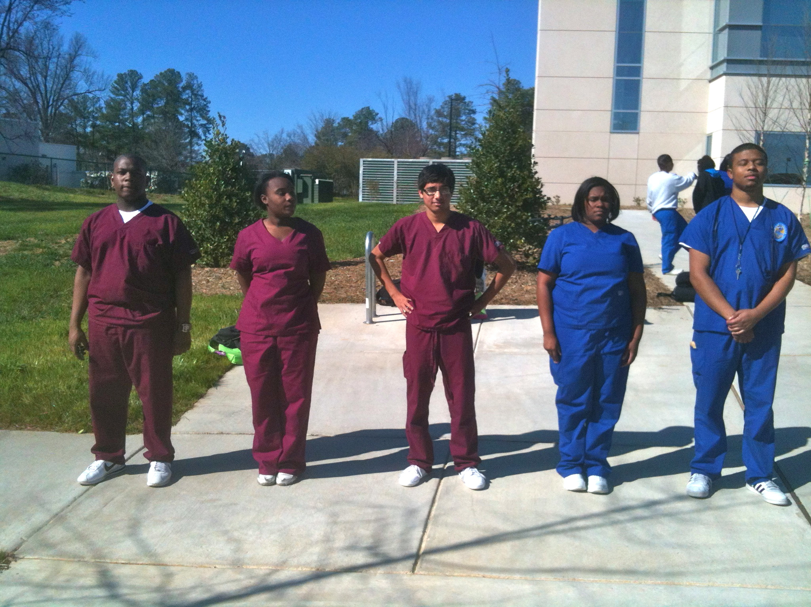
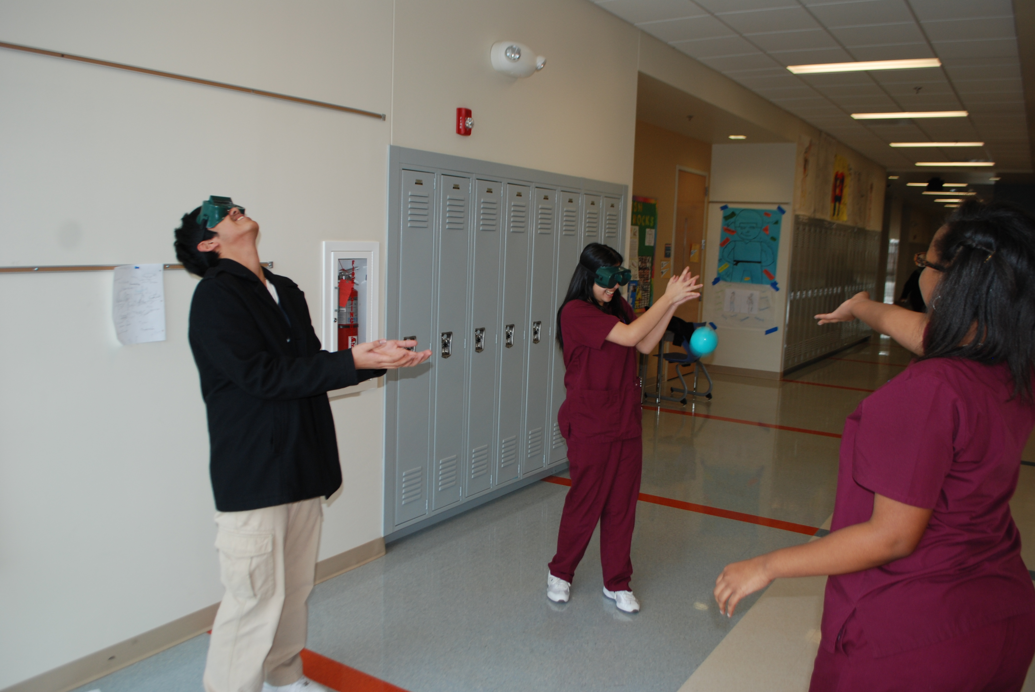
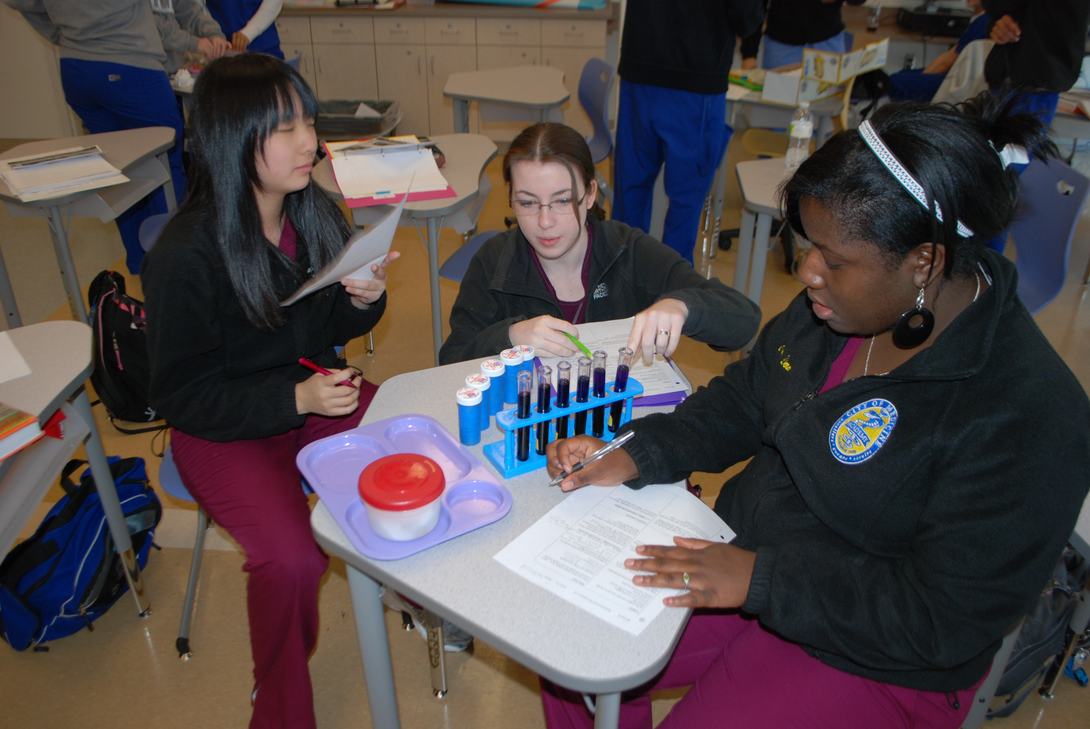
Why this matters to me.
My students!

Slide 4
Today’s goal:
How to infuse diversity into intro psych without it feeling “tacked on.”
My way of doing that is to find resources that are genuine, reflect diversity and are also excellent examples of psychological concepts.
Why being genuine matters: if you don’t have a passion and enthusiasm for the resources you choose, the students will feel it.

Slide 5
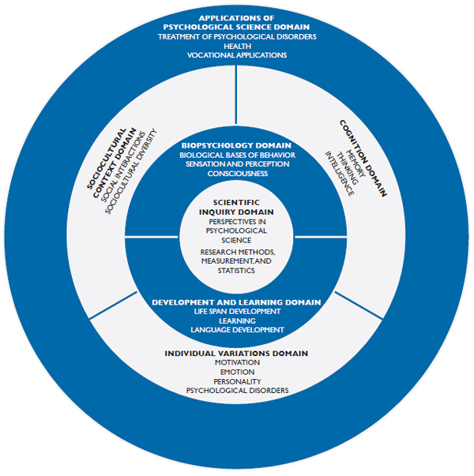
National Standards for High School Psychology Curricula
Here are the seven domains – but where is diversity?

Slide 6
Infusing Diversity Throughout the High School Psychology Course
“Teachers present psychological science through a lens that is both comprehensive and representative of today’s diverse student population.
Issues of race/ethnicity, culture, gender identity and expression, sexual orientation, disability, religion, socioeconomic status, national origin, and aging should be incorporated into the psychology course.”

Slide 7
APA’s Careers in Psychology
CAREERS
An excellent brochure featuring a very diverse group of psychologists.
(Updated in 2012)

Slide 8
WEIRD subjects
RESEARCH
“An analysis of top psychology journals found that 96% of subjects come from Western industrialized nations, which contain only 12% of the world's population.
•67% of American subjects and 80% of international subjects are undergraduate psychology students.
•An American undergraduate is 4,000 times more likely to be a subject in a psychology experiment than a random person outside the West.”
The subjects in many research studies are WEIRD societies: Western, Educated, Industrialized, Rich, and Democratic. See the journal article PDF and related story.
How can this affect our perceptions of normal behavior?

Slide 9
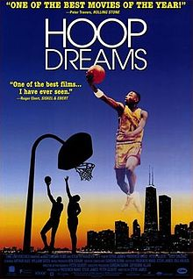
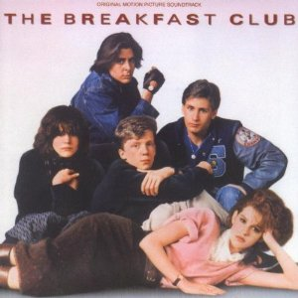
← Why show this …
LIFE SPAN DEVELOPMENT
… when you can show this? →
Hoop Dreams follows two high school freshmen over the next four+ years of life. It’s a great way to have students apply what they’ve learned about such as:
Identity development
Extrinsic and intrinsic motivation
Moral development
Stability v. change
Personality theories
Conformity
The trailer

Slide 10
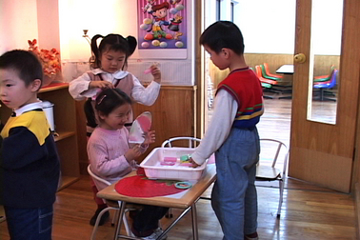
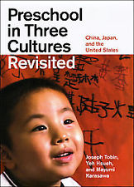
Preschool in Three Cultures
LIFE SPAN DEVELOPMENT
A look at preschool in Japan, China and the US
Researcher: Joseph Tobin, now at UGA

Slide 11
Preschool in Three Cultures
LIFE SPAN DEVELOPMENT
The method:
Videotape in a preschool
Ask the teachers and administrators in the school to review and comment
Ask other teachers and administrators in the same country to review and comment
Ask teachers and administrators in the other two countries to review and comment
Tobin: the selected school is “not representative, but not unrepresentative”

Slide 12
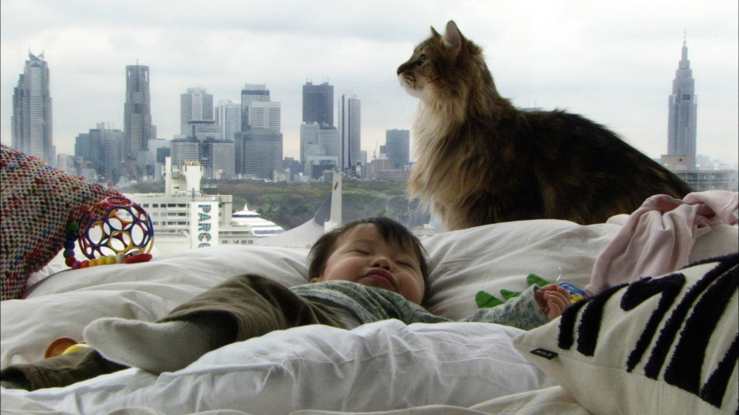
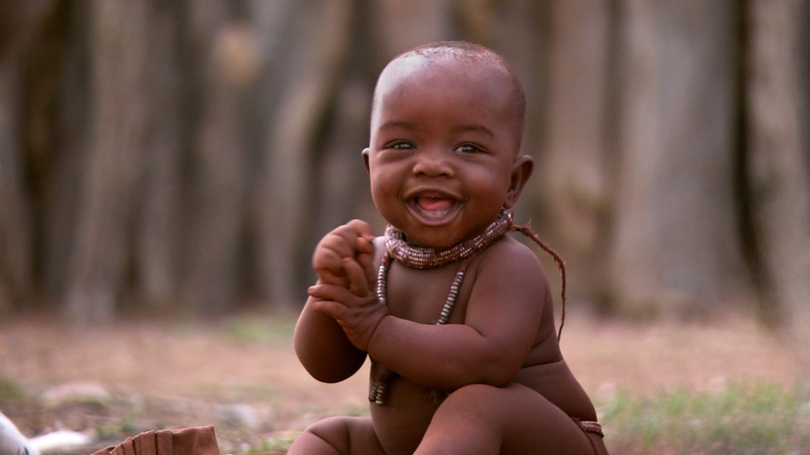
Babies
LIFE SPAN DEVELOPMENT
What’s fabulous about it, and …
Watch (online)
Photos from Focus Features

Slide 13
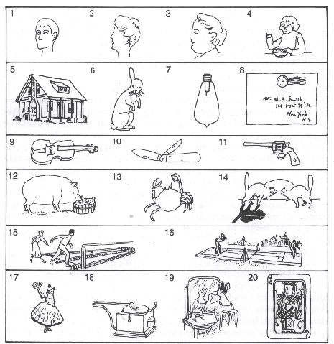
INTELLIGENCE
What’s missing?
Image from the Army Beta intelligence test

Slide 14
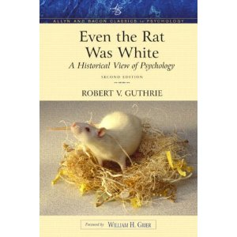
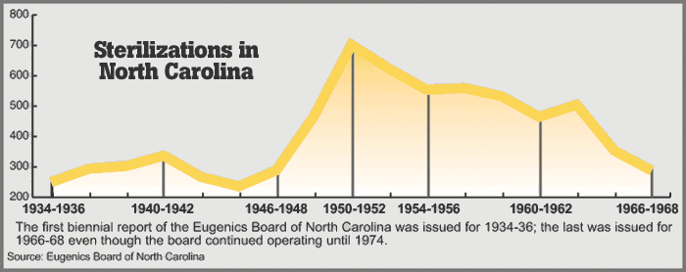
The history of intelligence testing
INTELLIGENCE
When you teach about this, be sure to include the social justice angle (thank you, Amy Fineburg!)
Flawed tests → Scientifically-based conclusions → Justification of racism/distrimination →
Sterilization
The average score of Black men was 10.4, which was considerably below the White average.
The APA committee led(including Yerkes, Goddard and Terman) developed the tests.
WEB Du Bois:
“For these tests were chosen 4730 Negroes from Louisiana and Mississippi and 28,052 white recruits from Illinois. The result? Do you need to ask?”
Source: Against Their Will

Slide 15
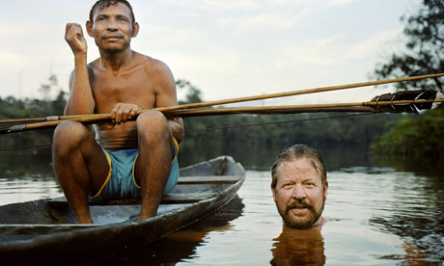
Is Noam Chomsky wrong?
LANGUAGE DEVELOPMENT
Anthropologist Daniel Everett studied the Pirahã tribe and made startling claims about their use of language.
The NYTimes story about the controversy.
Trailer Full ep. online!
The Grammar of Happiness documentary

Slide 16
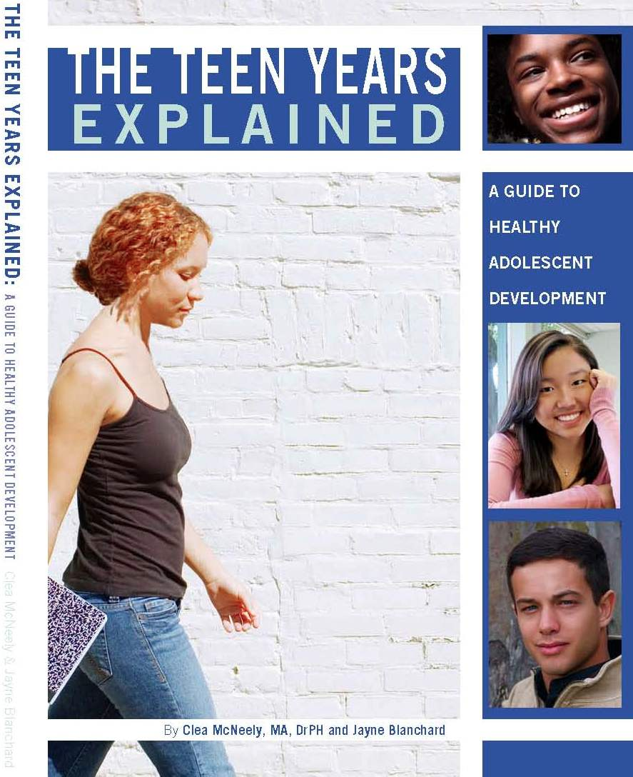
Some resources
Student-friendly
* The Teen Years Explained
* Under Pressure: What African-American Teens Aren’t Telling You About Sex, Love, and Relationships
Teachers only
* Diversity Resources for Psychology Courses
* Ethnic and Racial Disparities in Education: Psychology’s Contributions to Understanding and Reducing Disparities
* Resources for the Inclusion of Social Class in Psychology Curricula
* Toward an Inclusive Psychology: Infusing the Introductory Psychology Textbook with Diversity Content

Slide 17
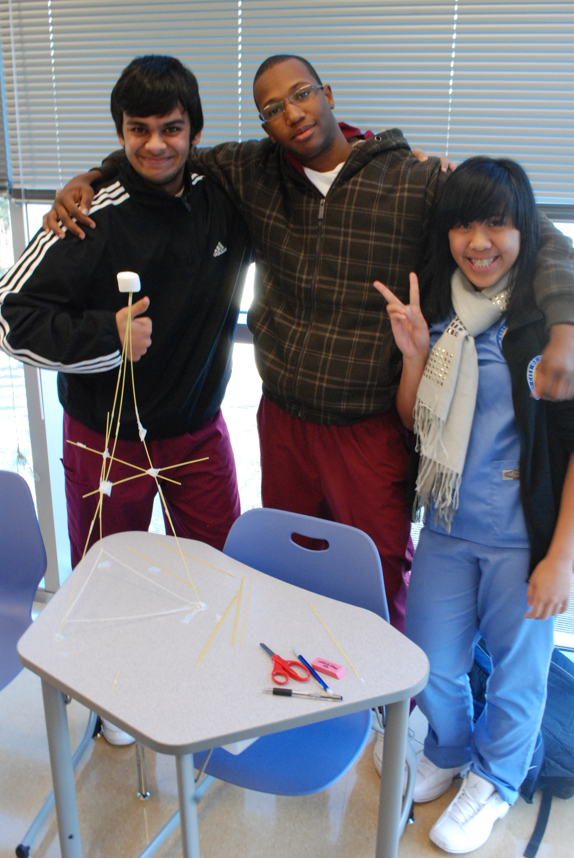
Thanks for coming!
steven.jones@ dpsnc.net

