Slide 1
The Intersection of Law and Psychology: Choose your Path
David Elbaum and Laura Brandt
Stevenson High School
Lincolnshire, IL.
teachinglawandpsychology.weebly.com

Slide 2
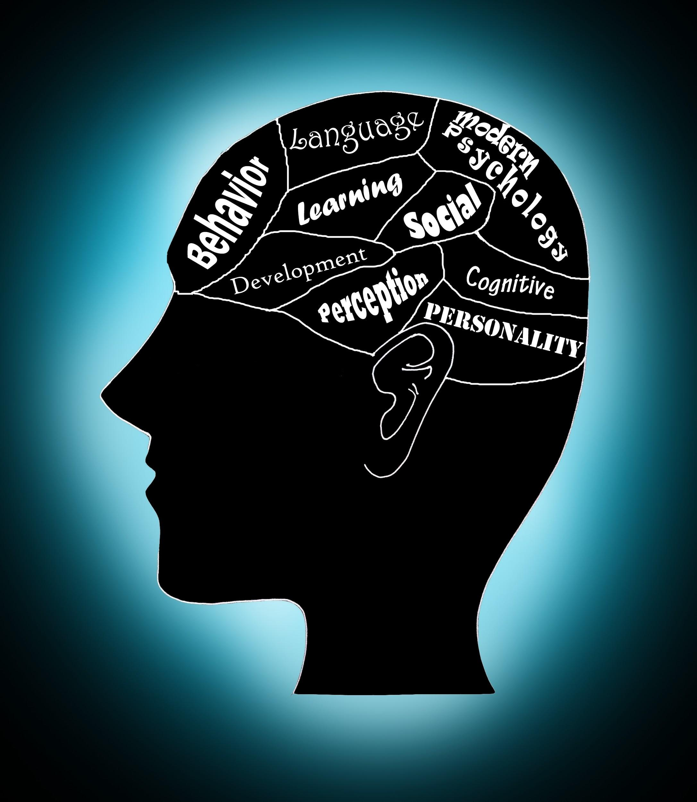
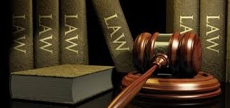
Evolution of Collaboration
Notes:
Starts off with classes as a post AP activity Elbaum
Evolves to Law Club/Psych Club
Goal: Collaborative class

Slide 3
Goals of the Presentation
Interdisciplinary work
Previewing work in other classes
Connecting new information to previously learned information
Post AP or end of the year activities
Student Interest
Extra Curricular (Psych Club/Law Club)

Slide 4
Topics of the Presentation
Insanity Defense: Disorders/Treatment
Eyewitness Testimony: Memory
Cruel and Unusual Punishment: Testing and Individual Differences
Coercion: Social Psychology
Confidentiality: Research/Ethics
Notes:
5 minutes in 2:45

Slide 5
Insanity Defense
Definition of Insanity: IL Code:
A person is not criminally responsible for conduct if at the time of such conduct, as a result of mental disease or mental defect, he lacks substantial capacity to appreciate the criminality of his conduct.
What does this look like in a criminal trial.
Burden of proof on the defendant (Insanity Defense Reform Act of 1984)
Notes:
“we are conducting this presentation as if we were teaching our class”
successful less than 1% of the time

Slide 6
Criminal Responsibility
The Irresistible Impulse Rule: People are not responsible for their actions if they were unable to control them at the time of the crime.
M’Naghten Rule: People are not responsible for their actions if they were unable to recognize the difference between right and wrong.
The Model Penal Test : People are not responsible for their crime if they were unable to appreciate the criminality of their actions at the time of the crime due to mental disease or defect.
Notes:
1843: Daniel M'Naghten shot and killed the secretary (Edward Drummond)of the British Prime Minister (Robert Peel), believing that the Prime Minister was conspiring against him. The court acquitted McNaughton "by reason of insanity," and he was placed in a mental institution for the rest of his life. However, the case caused a public uproar, and Queen Victoria ordered the court to develop a stricter test for insanity.
Standard for insanity in roughly half of all states

Slide 7
Insanity Defense
Minds on Trial: Great Cases in Law and Psychology
You are on the Jury
Directions: With a small group, discuss each question that you may be presented with as a juror to determine the outcome of the case. What other information would you need to make your decision?
Notes:
John Hinckley

Slide 8
Hinckley

Slide 9
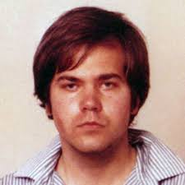
Case Study: John Hinckley
John Hinckley is well known for shooting President Ronald Reagan, but the details of his life are less well known. As a teenager, he was a loner who did not have friends and isolated himself playing guitar who hoped to be a songwriter. He became obsessed with guns and the violent film Taxi Driver as well as the film’s star Jodi Foster. He wrote Foster letters and poems and spoke to her by phone on a number of occasions. John’s psychiatrist encouraged his parents to stop paying John’s bills and allowing him to be jobless; they followed this request. Shortly thereafter, he shot President Reagan and wounded three others in an attempt to impress Foster. Experts disagreed on the disorder from which Hinckley suffered and diagnoses ranging from schizophrenia to narcissism were posed. In order to be found innocent by reason of insanity, Hinckley had to lack the capacity to understand that what he did was wrong. Indicate what information you would need as a juror to determine if Hinckley was innocent by reason of insanity?
Notes:
Goal: 15 minutes in at this point 2:55 done

Slide 10
Clark v. Arizona (2006)
SCOTUS upheld Arizona's limitations on the insanity defense. In that same ruling, the Court noted "We have never held that the Constitution mandates an insanity defense, nor have we held that the Constitution does not so require."

Slide 11
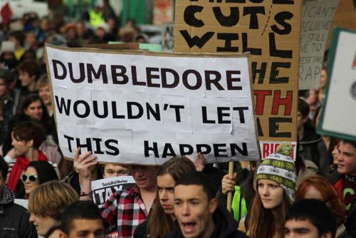
Word Demonstration
Notes:
Ocean and Octopus added

Slide 12
The Crime

Slide 13
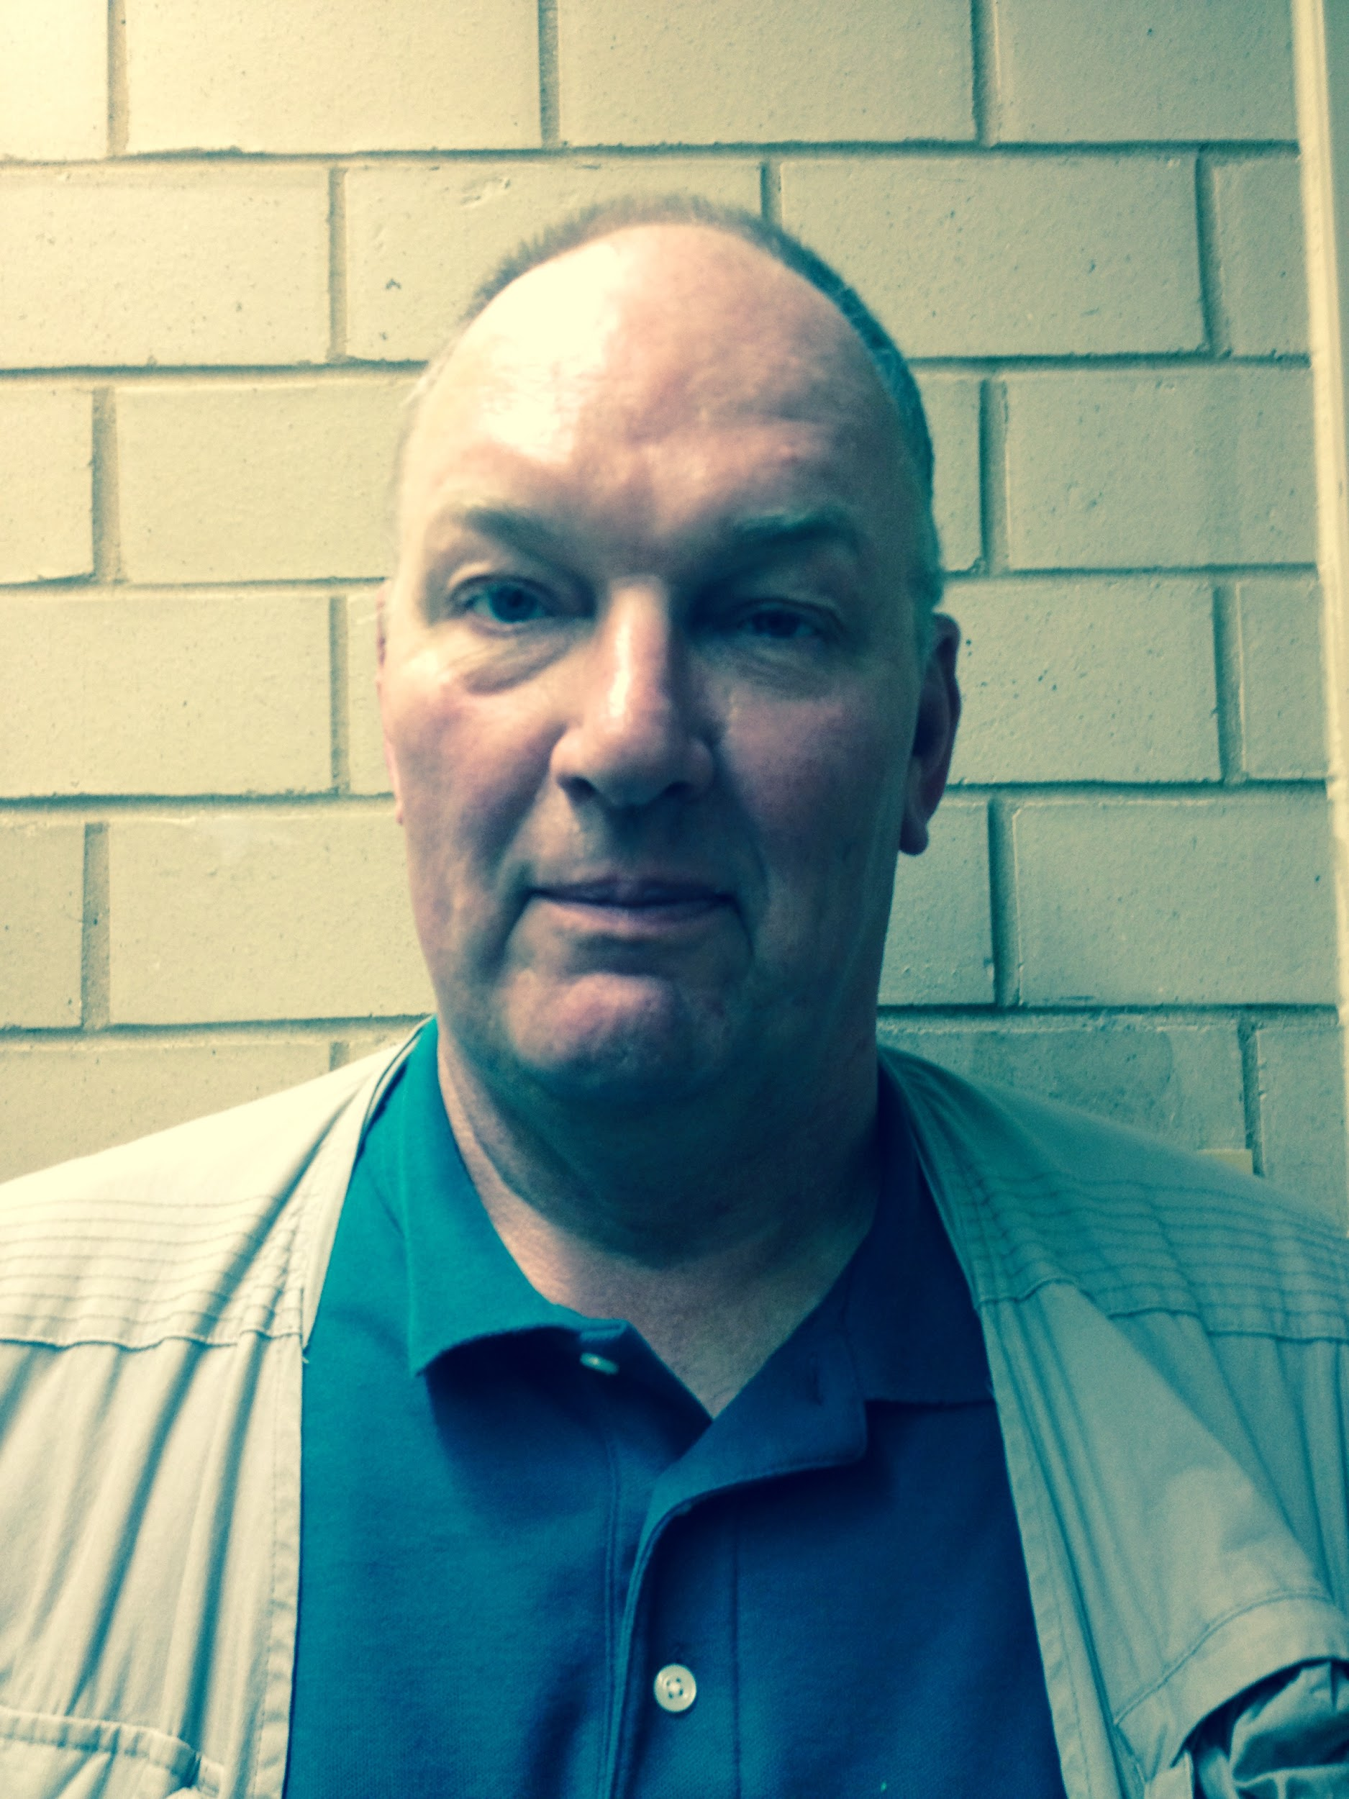
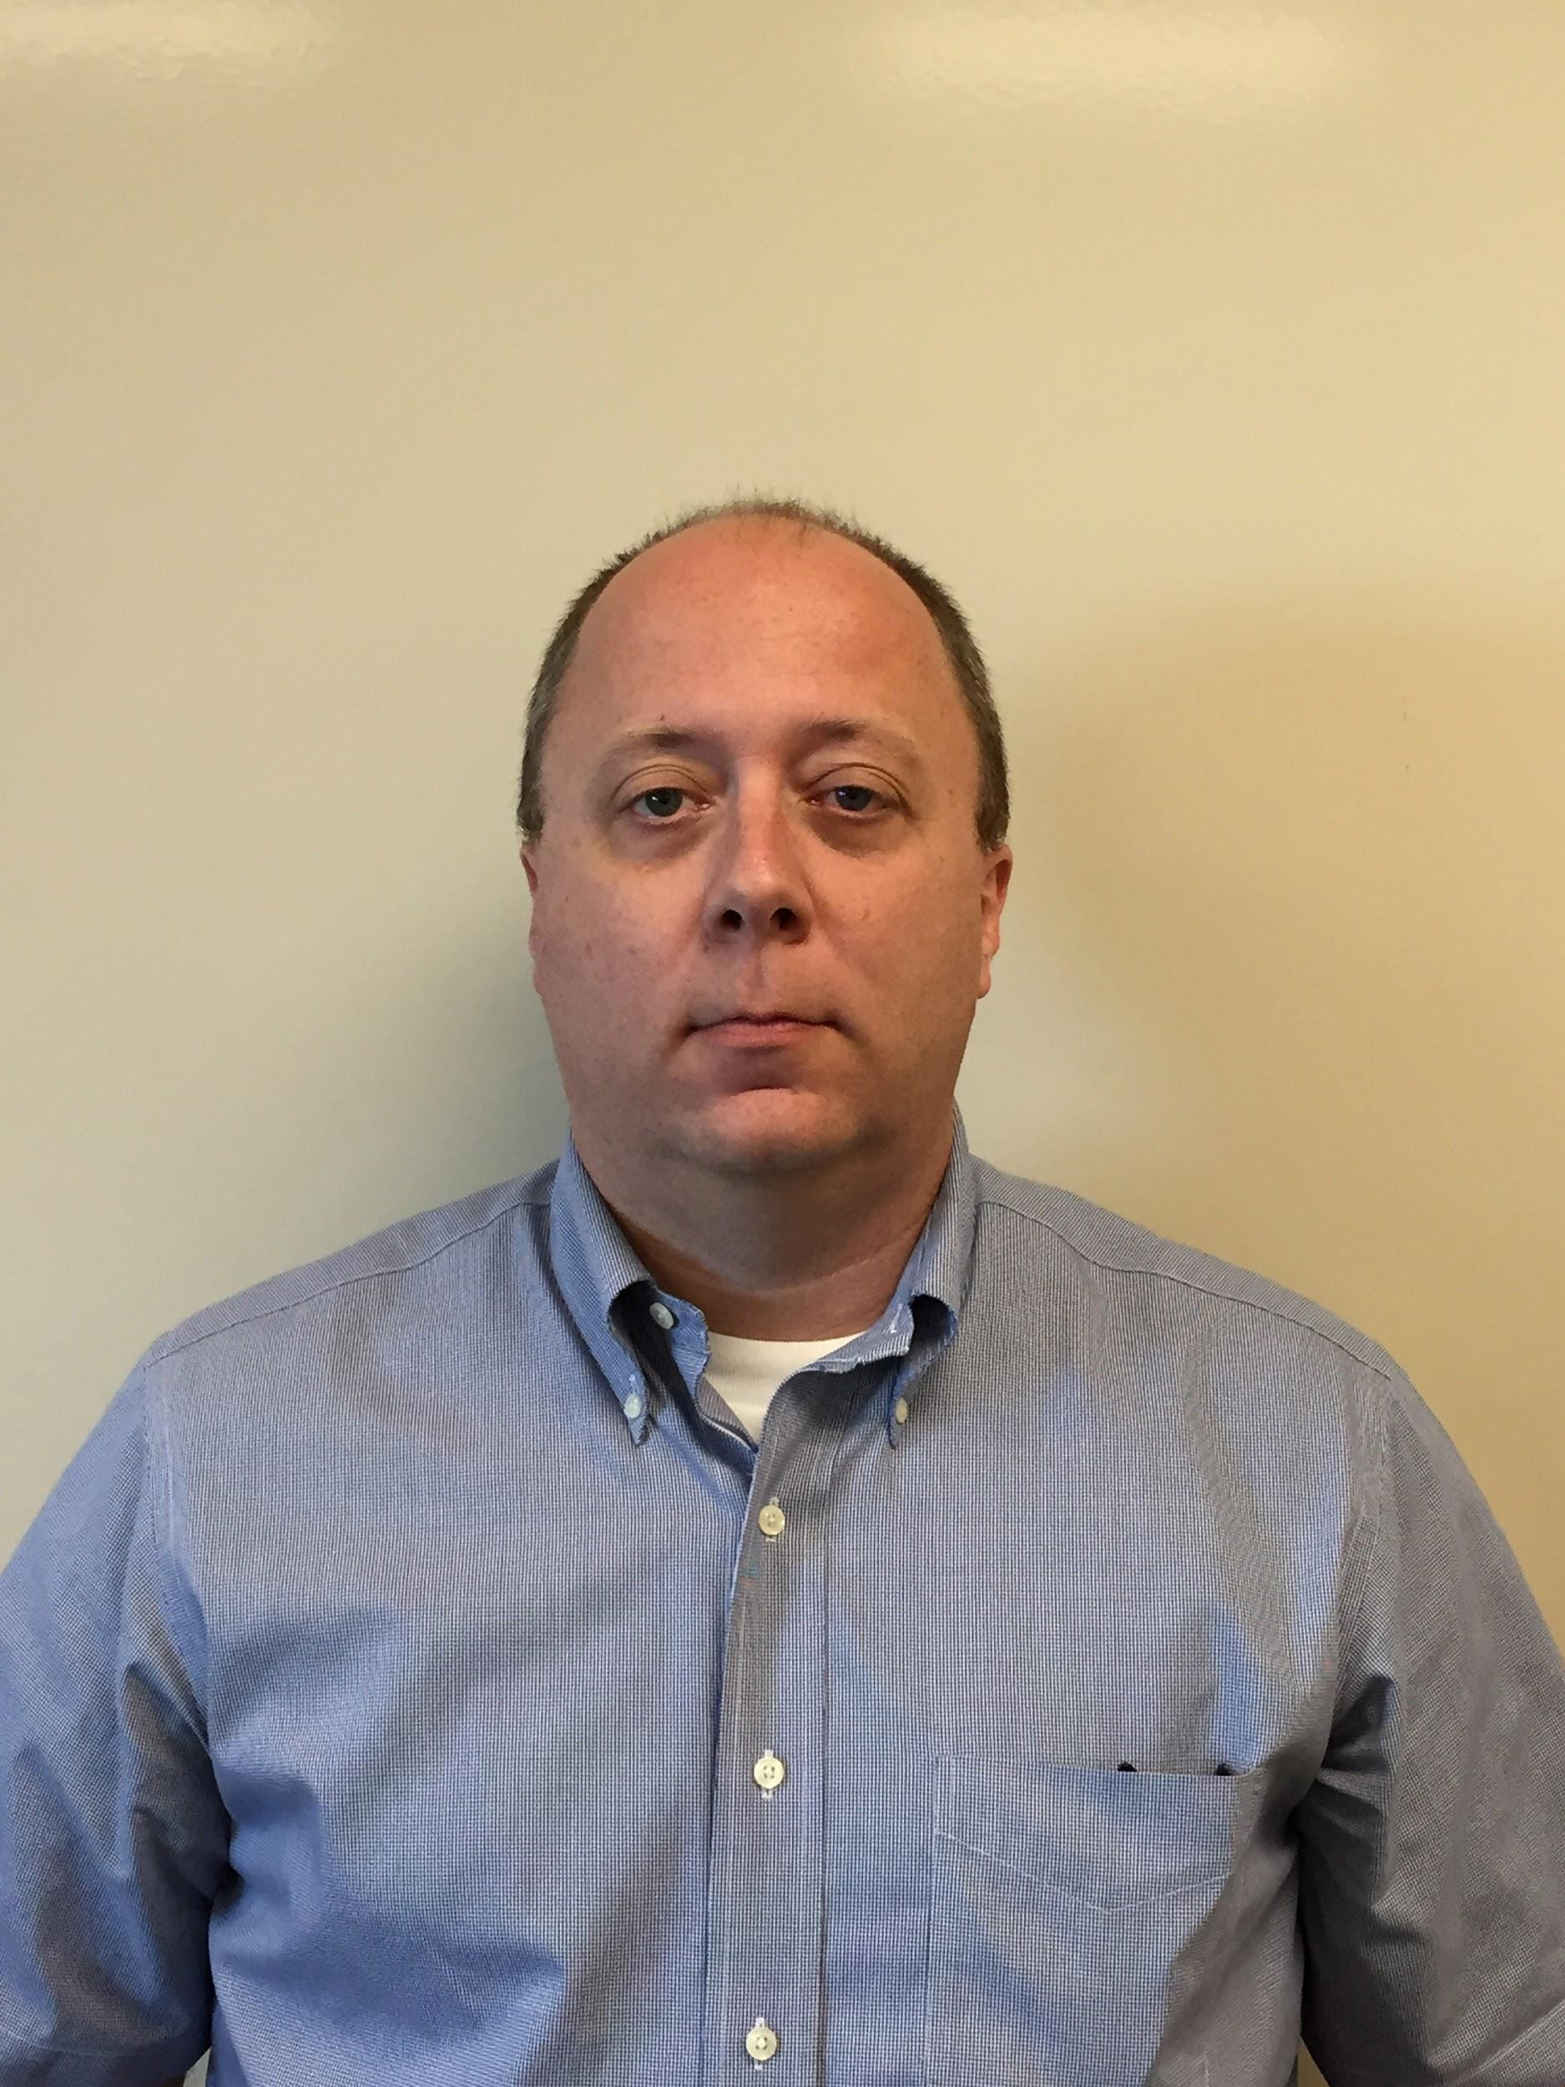
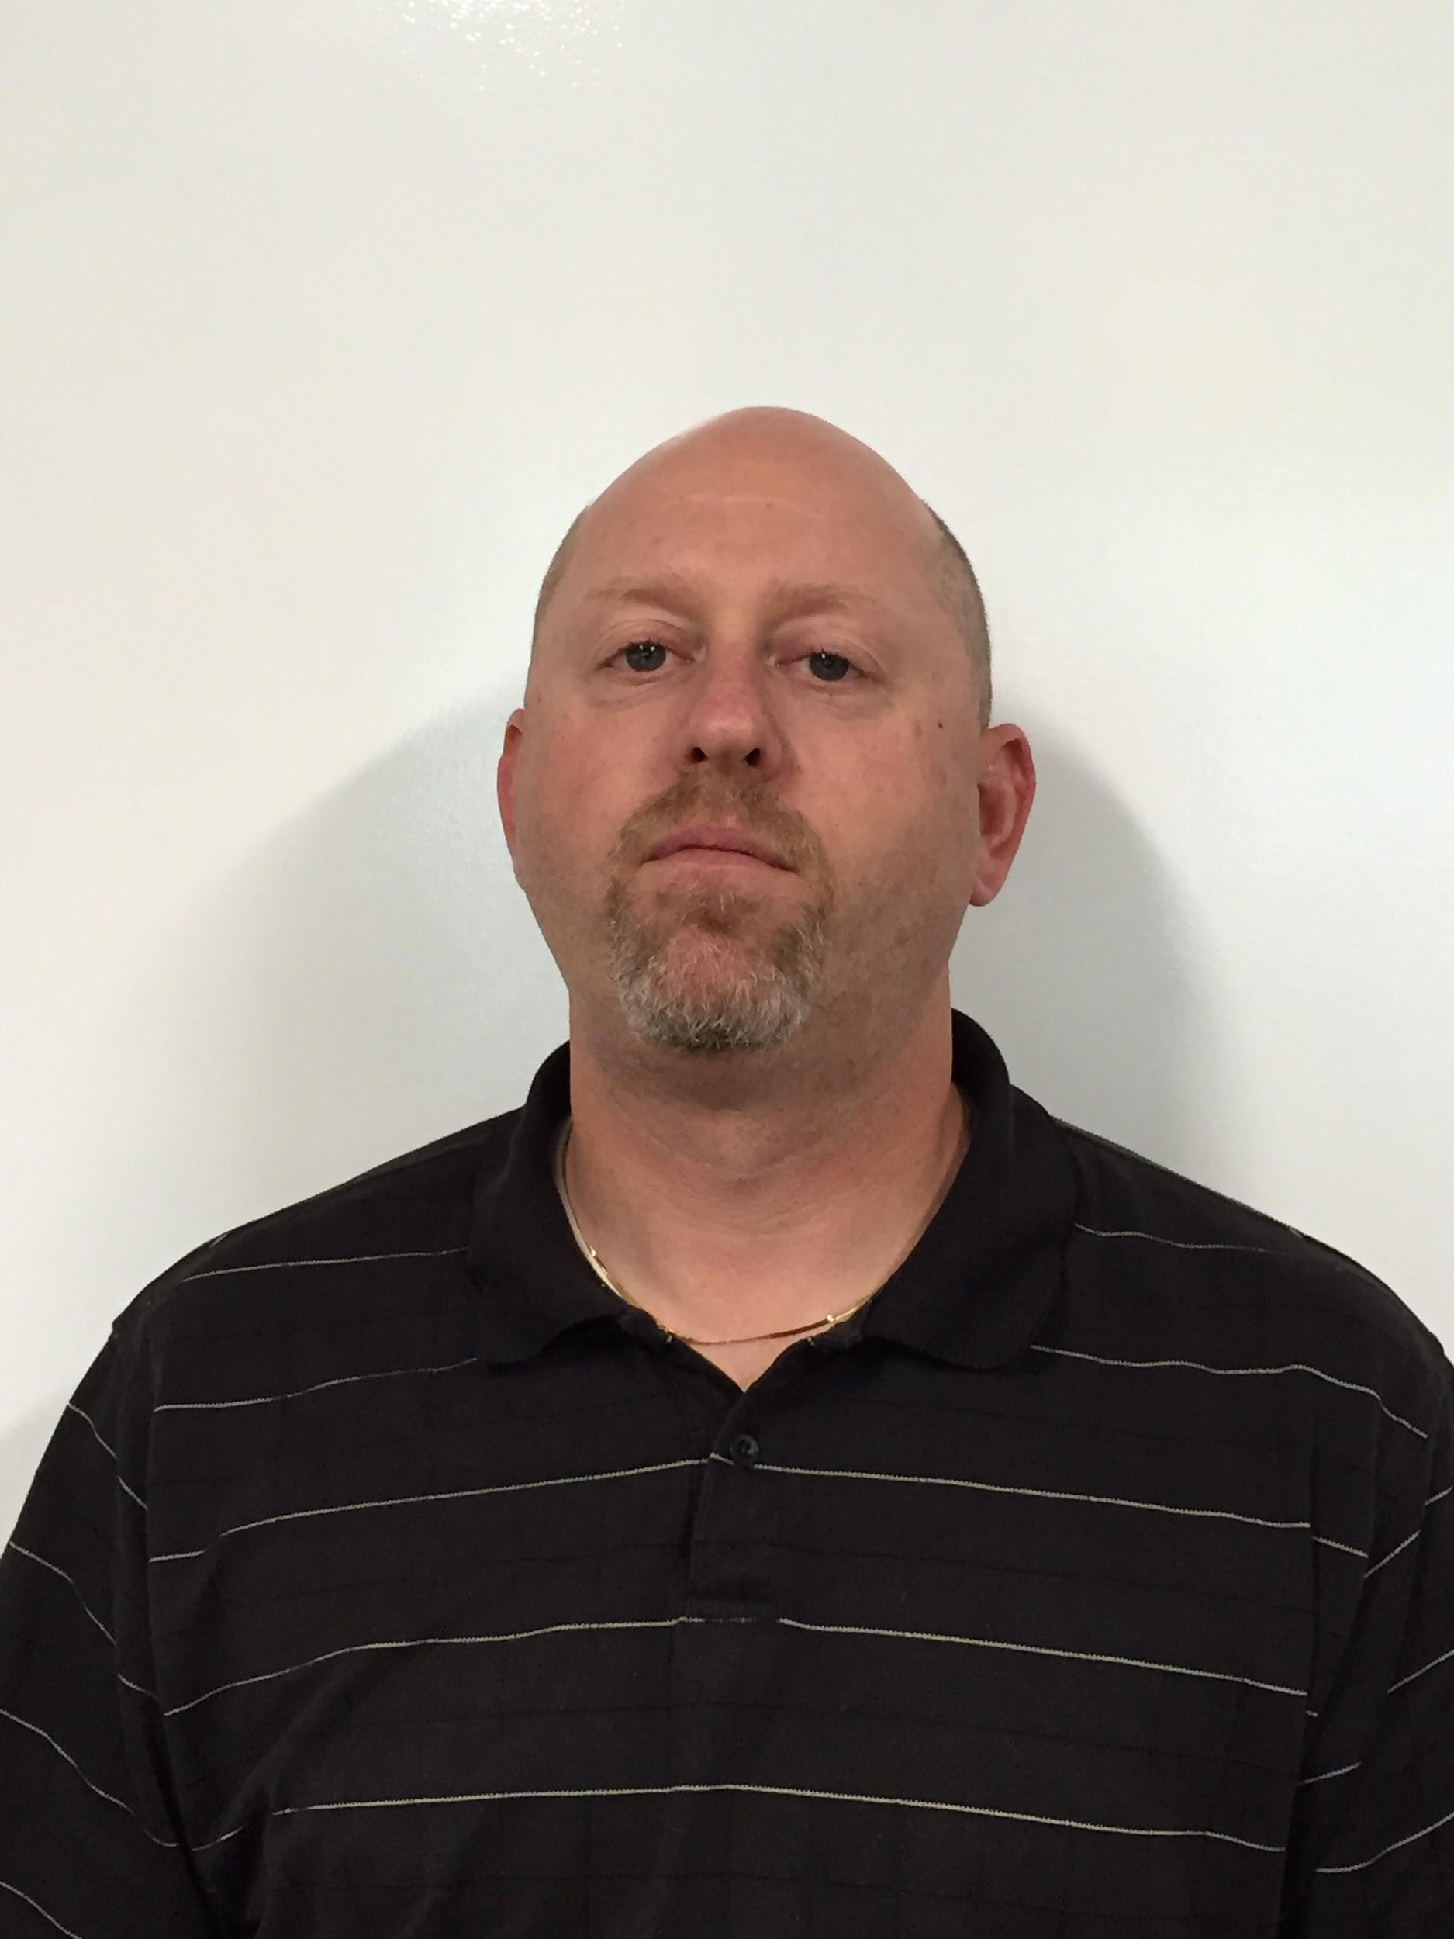
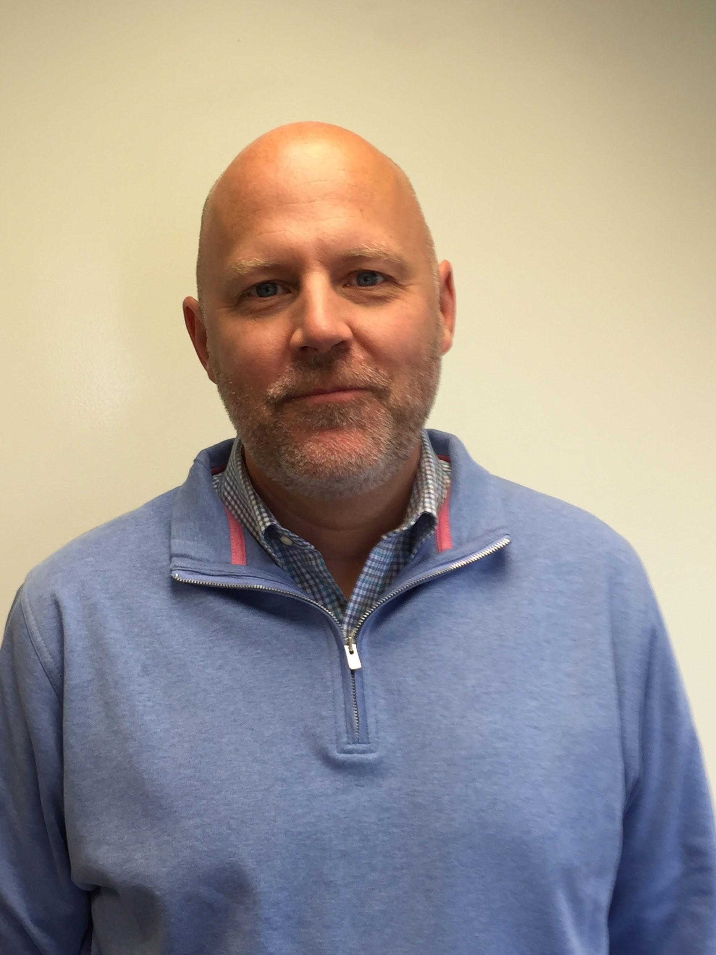
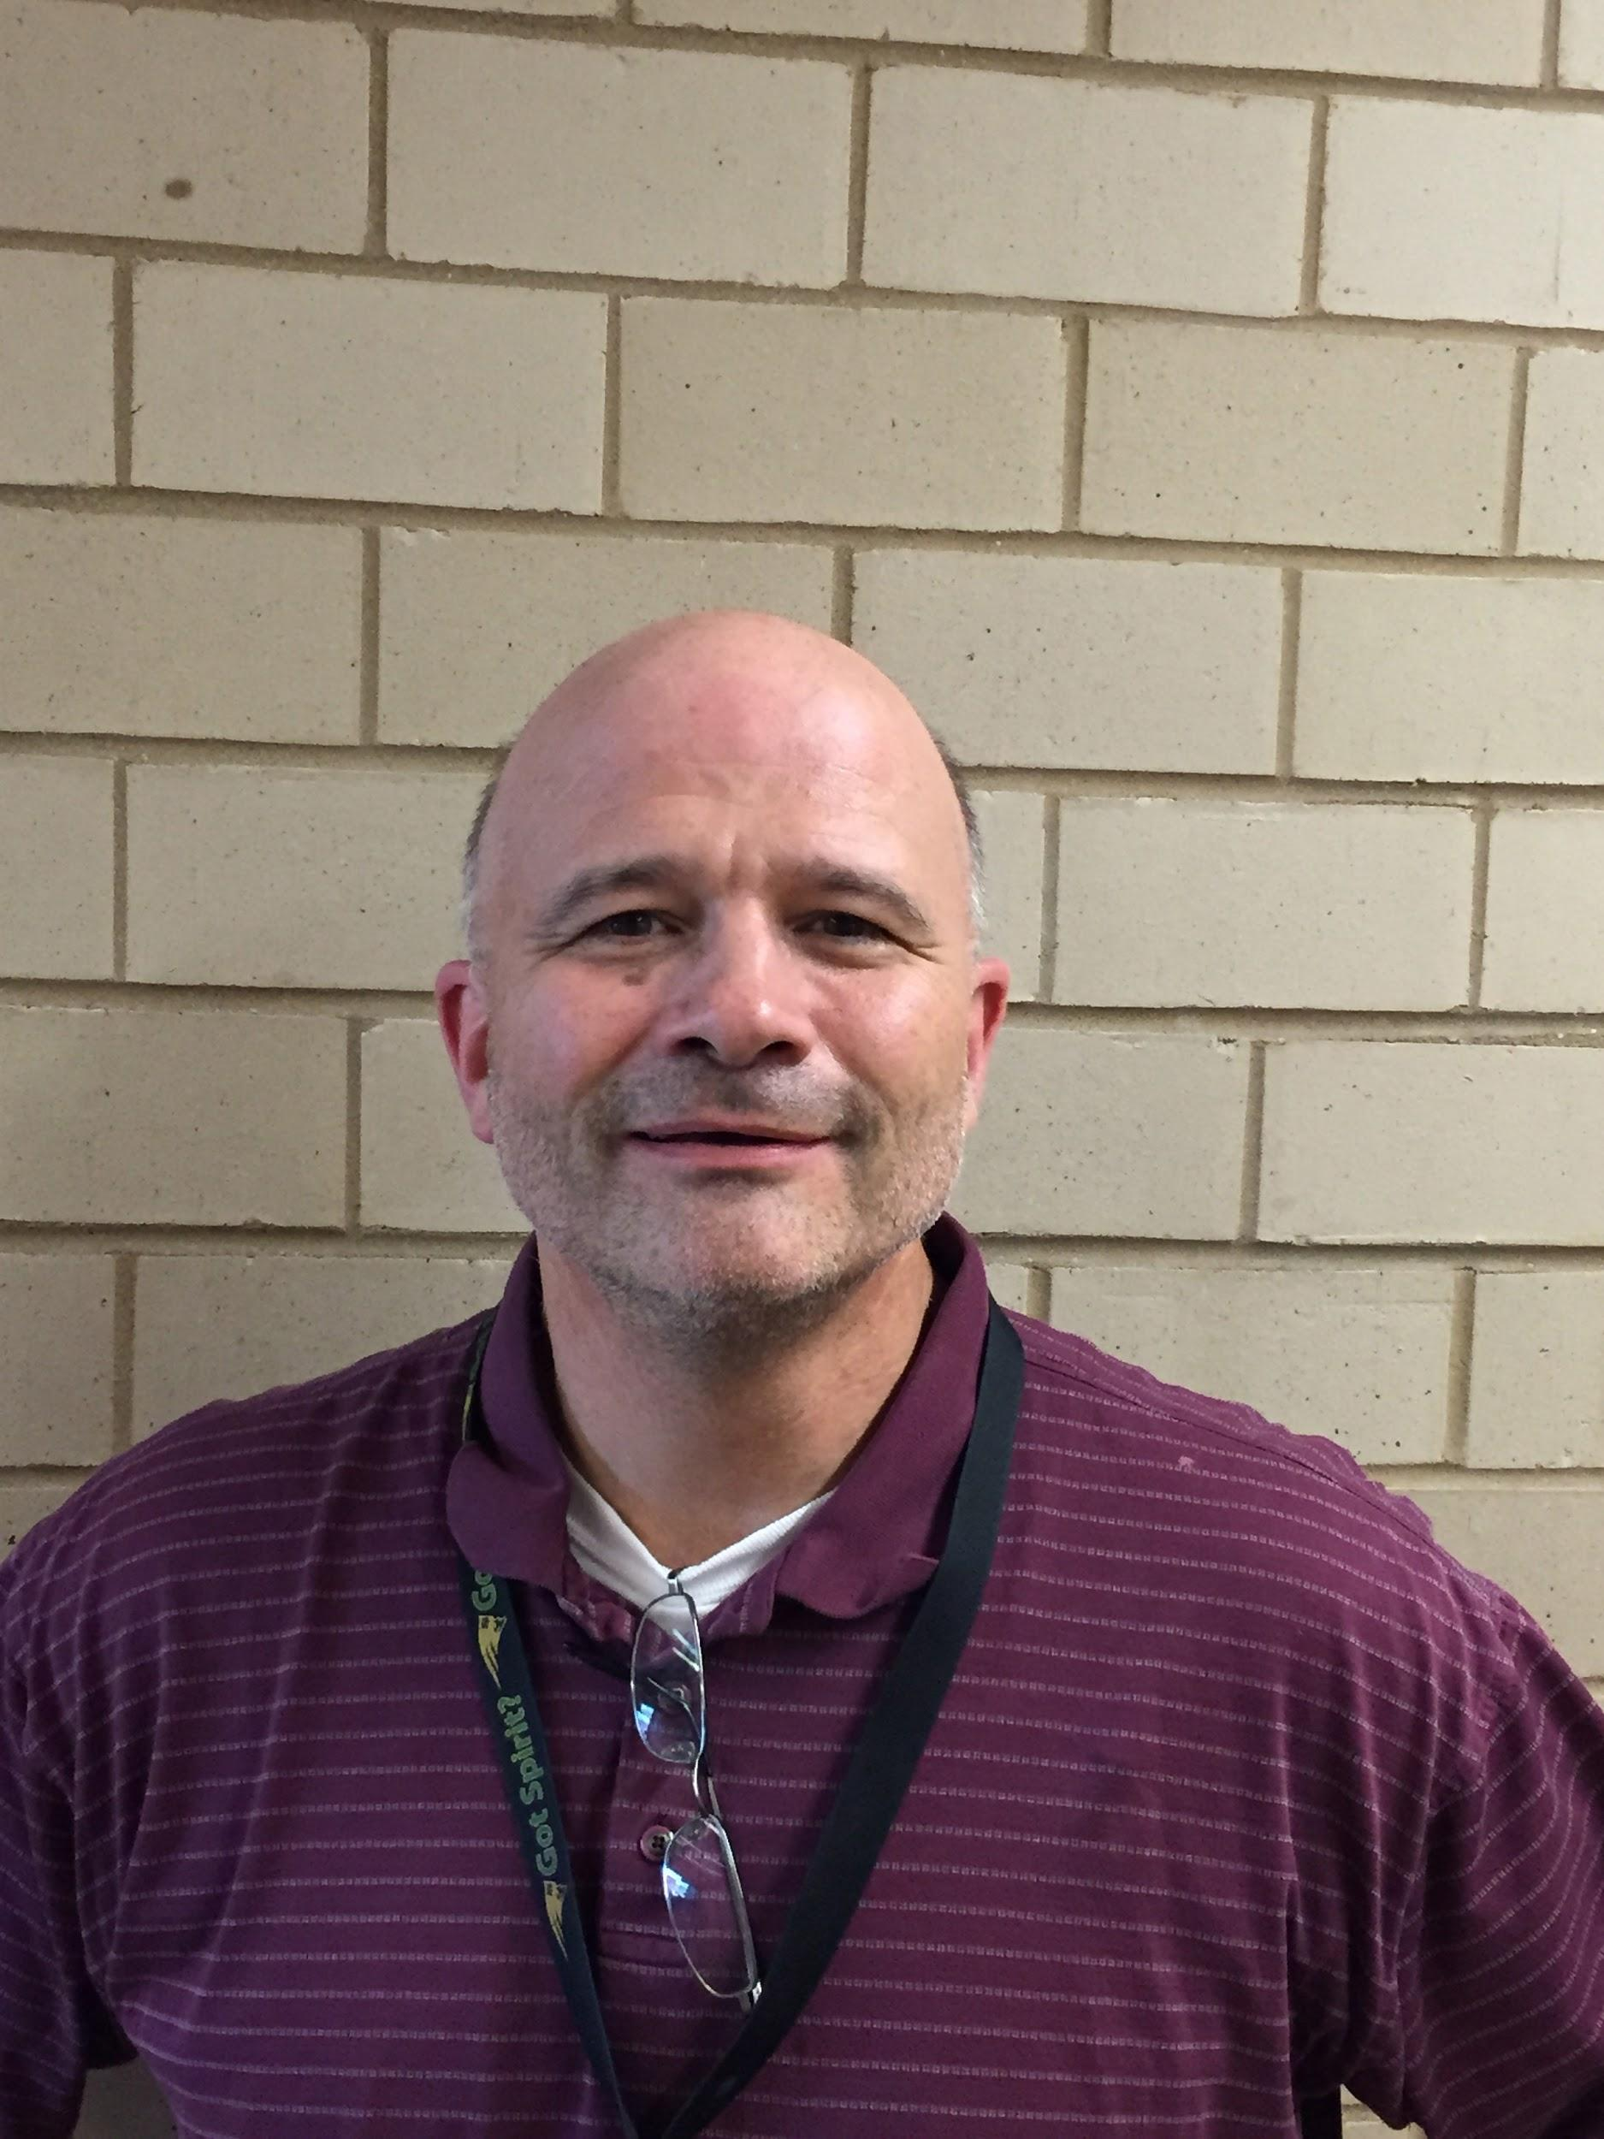
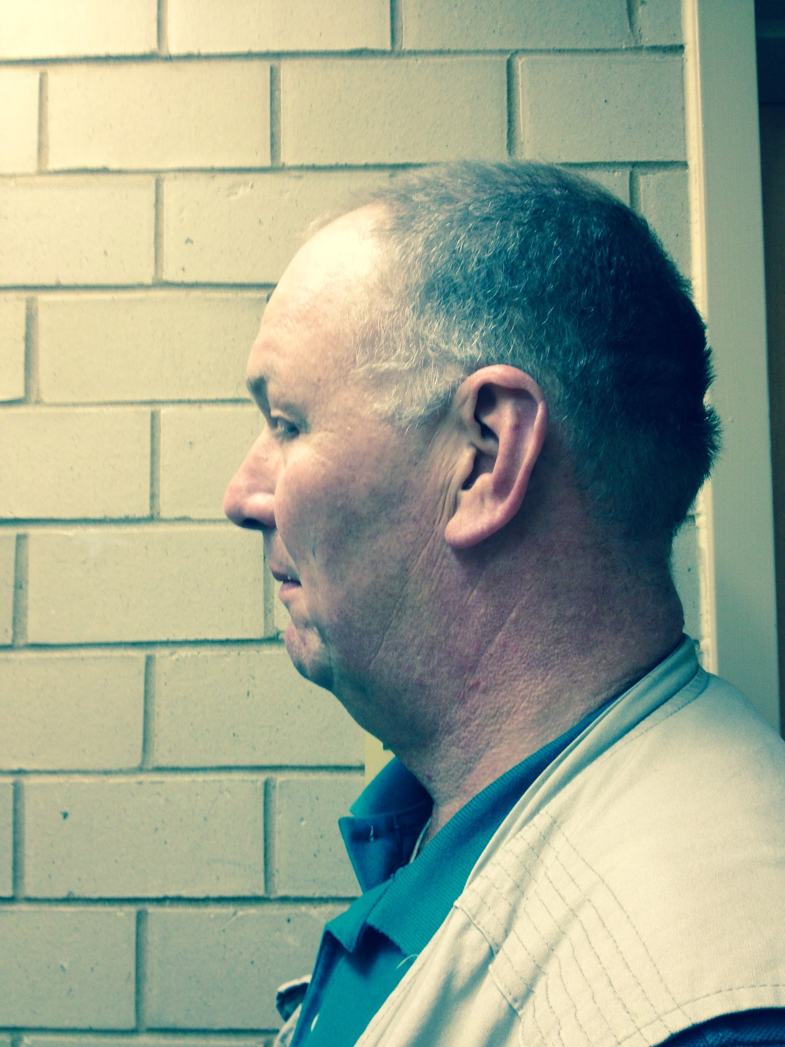
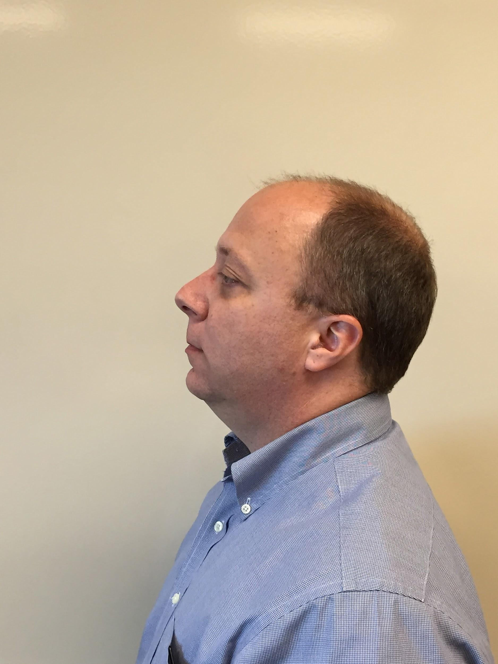
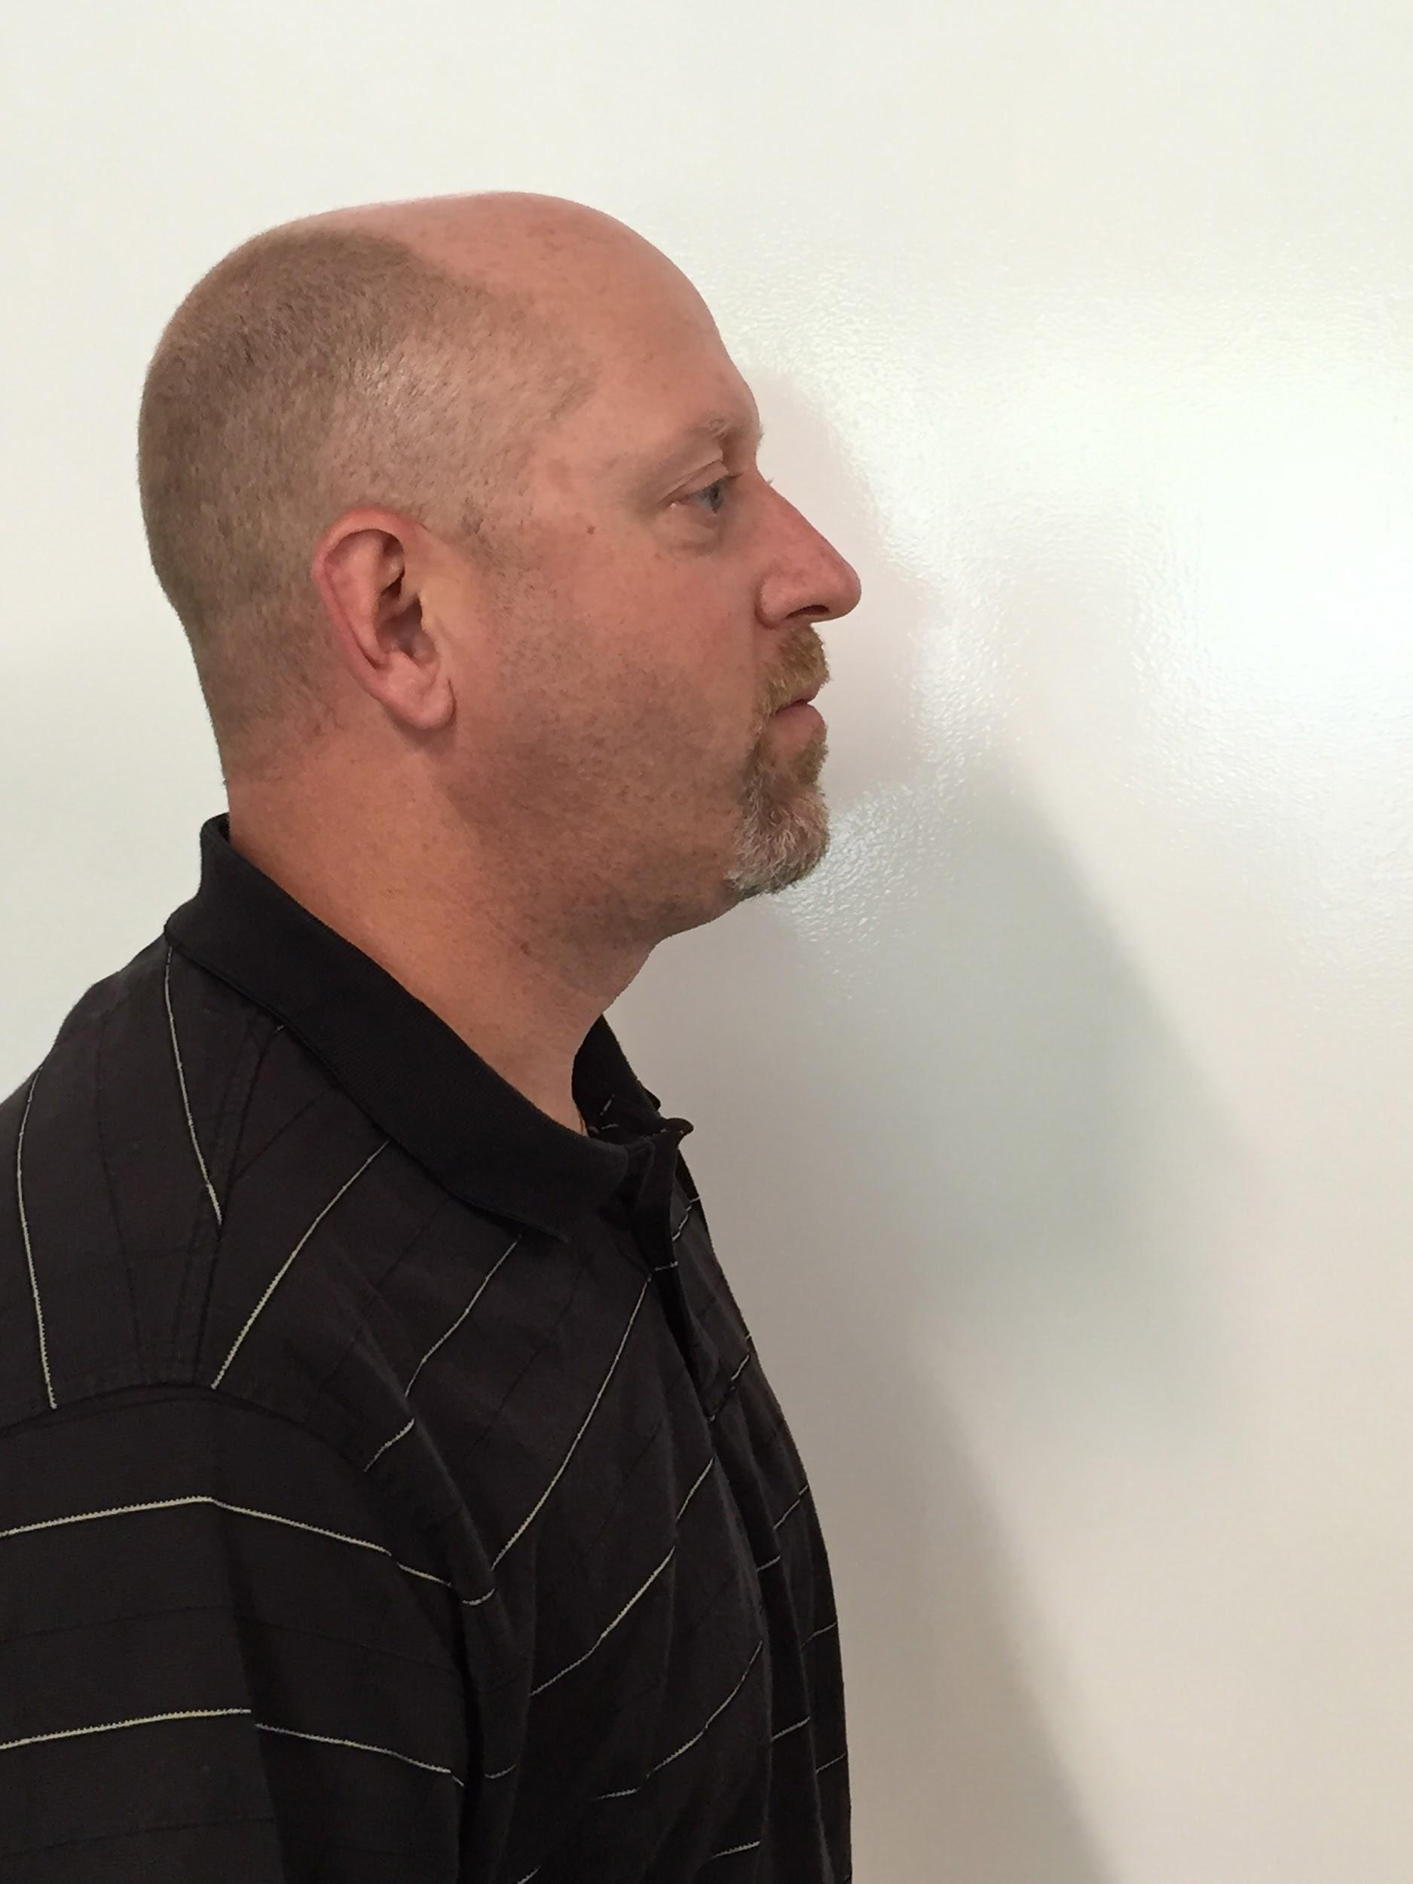
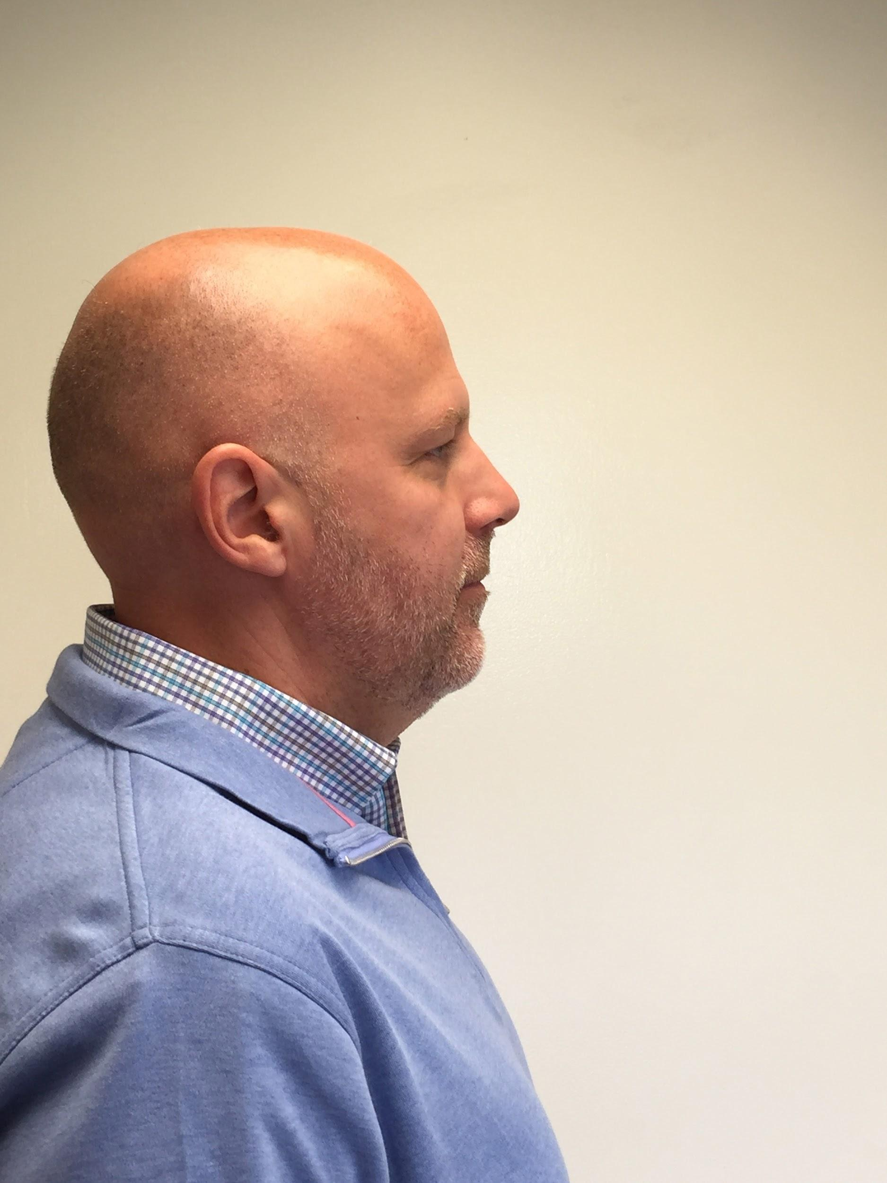
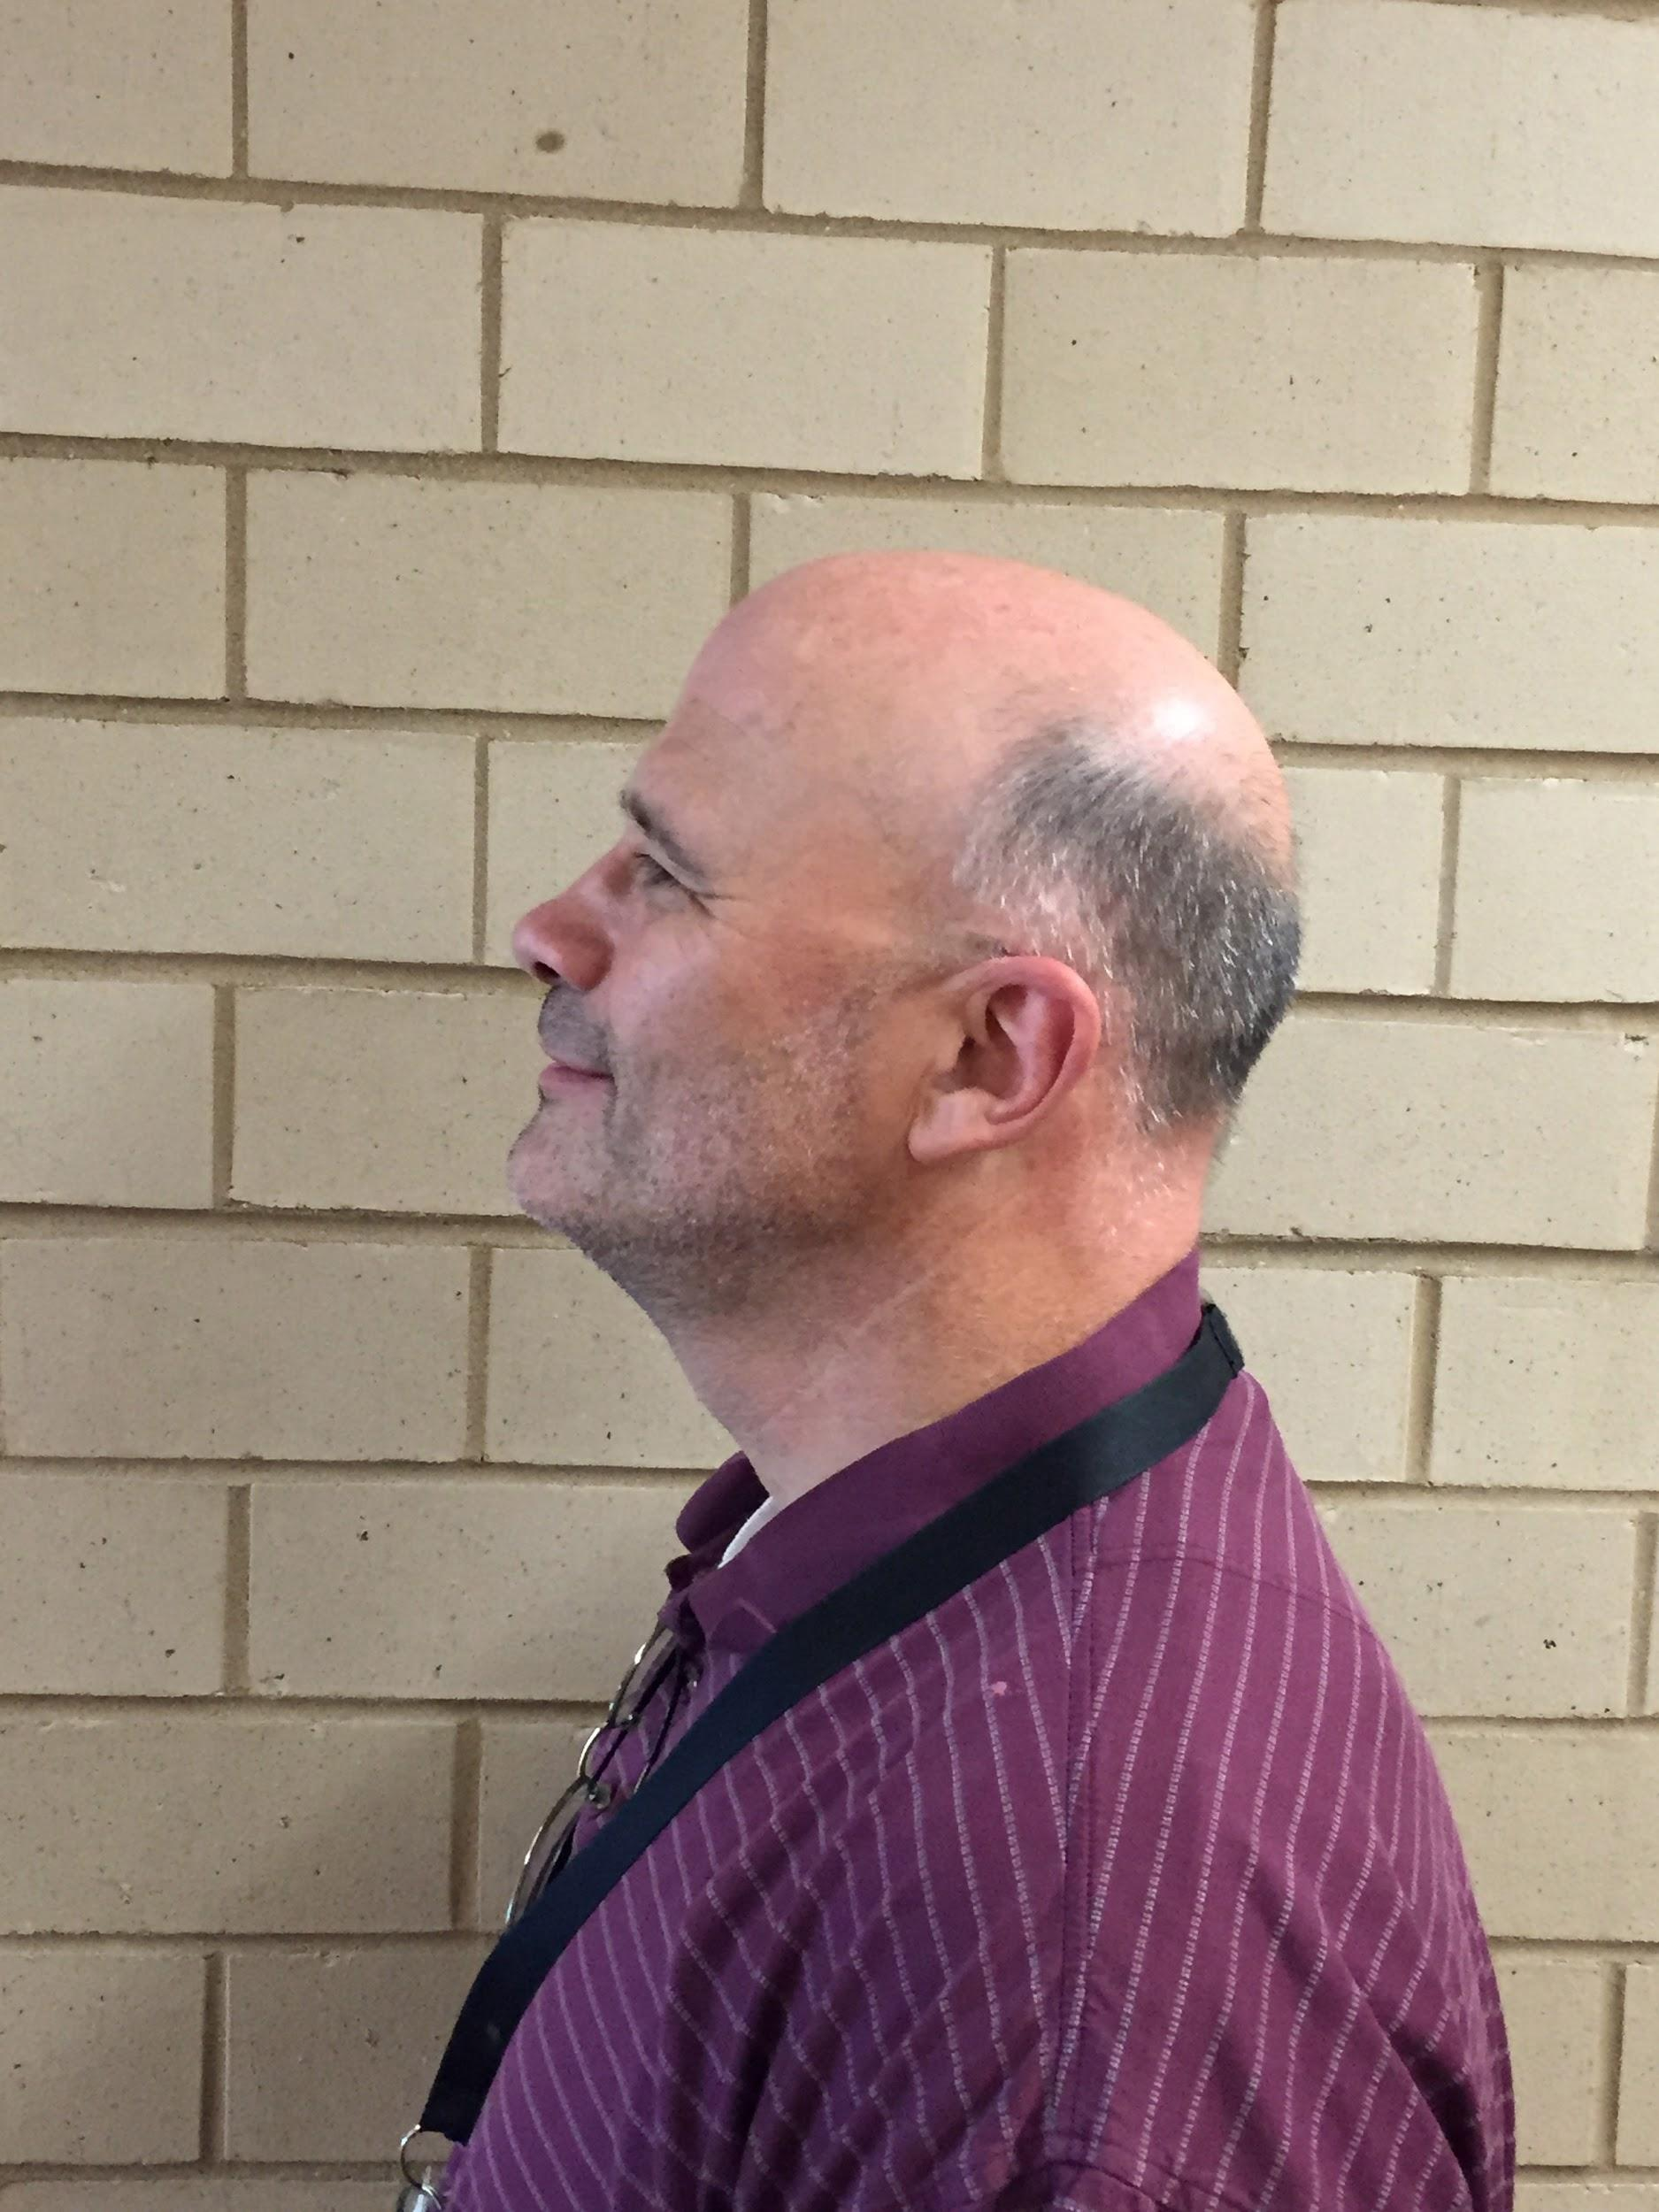
1
2
3
4
5
Notes:
60 minutes Ronald Cotton

Slide 14
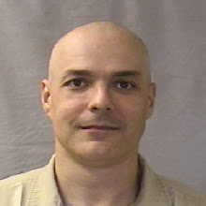
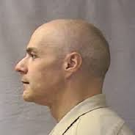
1
2
3
4
5
Notes:
how good of a look did you get at the culprit? 35 minutes into presentation 3:15
How confident are you with your answer?

Slide 15
“Excessive bail shall not be required, nor excessive fines imposed, nor cruel and unusual punishments inflicted” -8th Amendment to US Constitution
Prongs of Cruel and Unusual Punishment
The severe punishment is:
Degrading to human dignity
Arbitrary
Rejected by society
patently unnecessary (punishment doesn’t fit the crime)
Notes:
Death Penalty, Mentally Ill
Elbaum

Slide 16
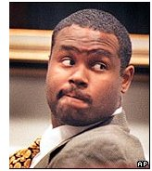
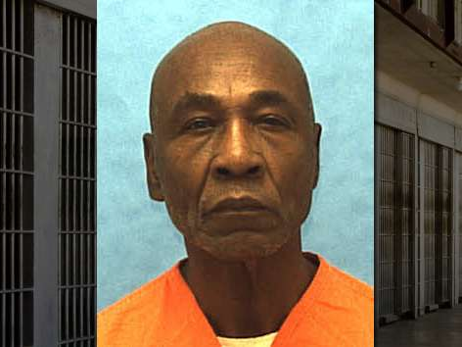
Death Penalty for the Intellectually Disabled
Atkins v. Virginia (2001)
IQ between 54-74
Hall v. Florida (2014)
“Hard IQ” at 70

Slide 17
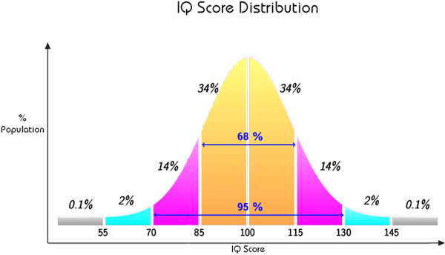
IQ Scores
Scores should be considered a range rather than a definitive score.
There is measurement error in any score
Standard Error of Measurement if 2.5point on the WAIS-III

Slide 18
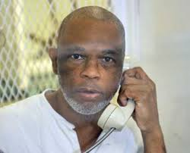
Marvin Wilson
Before his conviction, Wilson scored 73 on an IQ test at the age of 13, and 75 when he was 29. While on death row he scored 61, 75 and 79 on three different tests.
Notes:
Killed 2012, Huntsville Texas. in 1994 convicted of killing a police drug informant. Lawyer missed deadline to protest low IQ so not admissible

Slide 19
Coercion
False Confessions
http://www.cbsnews.com/news/chicago-the-false-confession-capital/

Slide 20
Coercion
Confirmation Bias: The police think they have found the culprit and anything the individual says will be interpreted as their guilt.
Hindsight Bias: After hearing a witness choose someone out of a lineup, police may suggest they knew all along this person was guilty.
Framing Effect: How questions are posed during interrogations may impact the responses witnesses provide. “Did you see this person here with a weapon?” versus “Did you see anyone with a weapon?”

Slide 21
Confidentiality
According to the APA a clinician can violate confidentiality when someone is a danger to themselves of others.
Notes:
reference packet

Slide 22
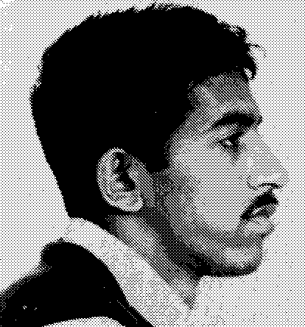
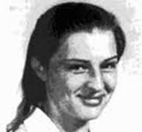
Confidentiality: Prosenjit Poddar

Slide 23
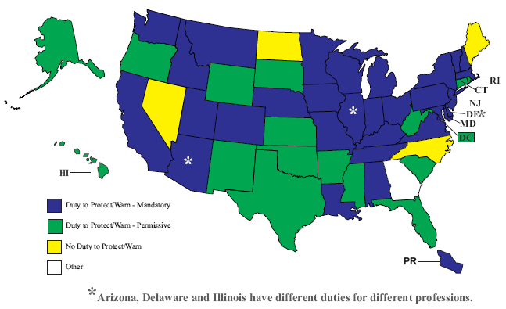
Duty to Warn v. Duty to Protect

Slide 24
Closing
Laura Brandt: lbrandt@d125.org
David Elbaum: delbaum@d125.org
teachinglawandpsychology.weebly.com

